Slide 1
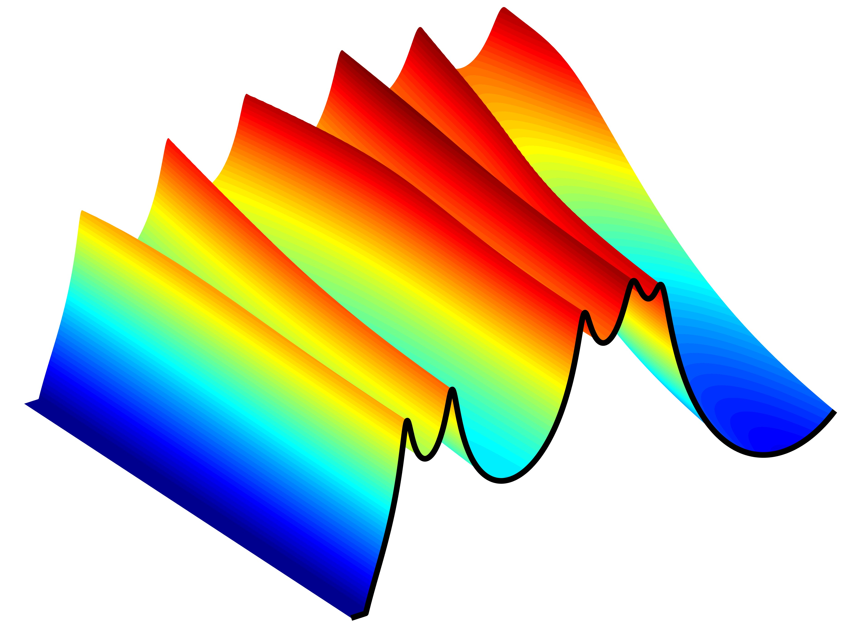
Tuning vocal tract Resonances to enhance voice quality
PAVA 10.16.16
Brad Story
Speech Acoustics Laboratory
Speech, Language, and Hearing Sciences
University of Arizona

Slide 2
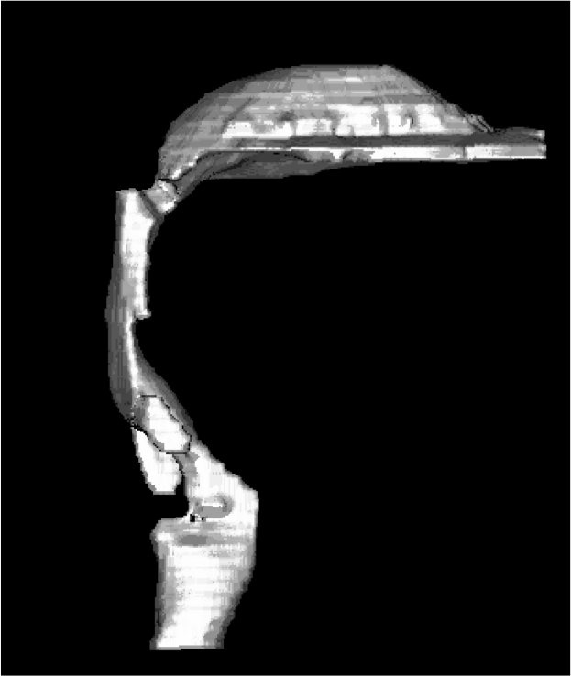
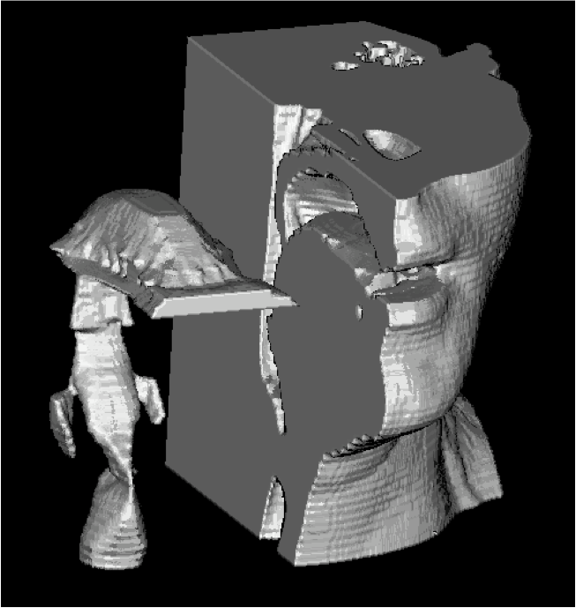
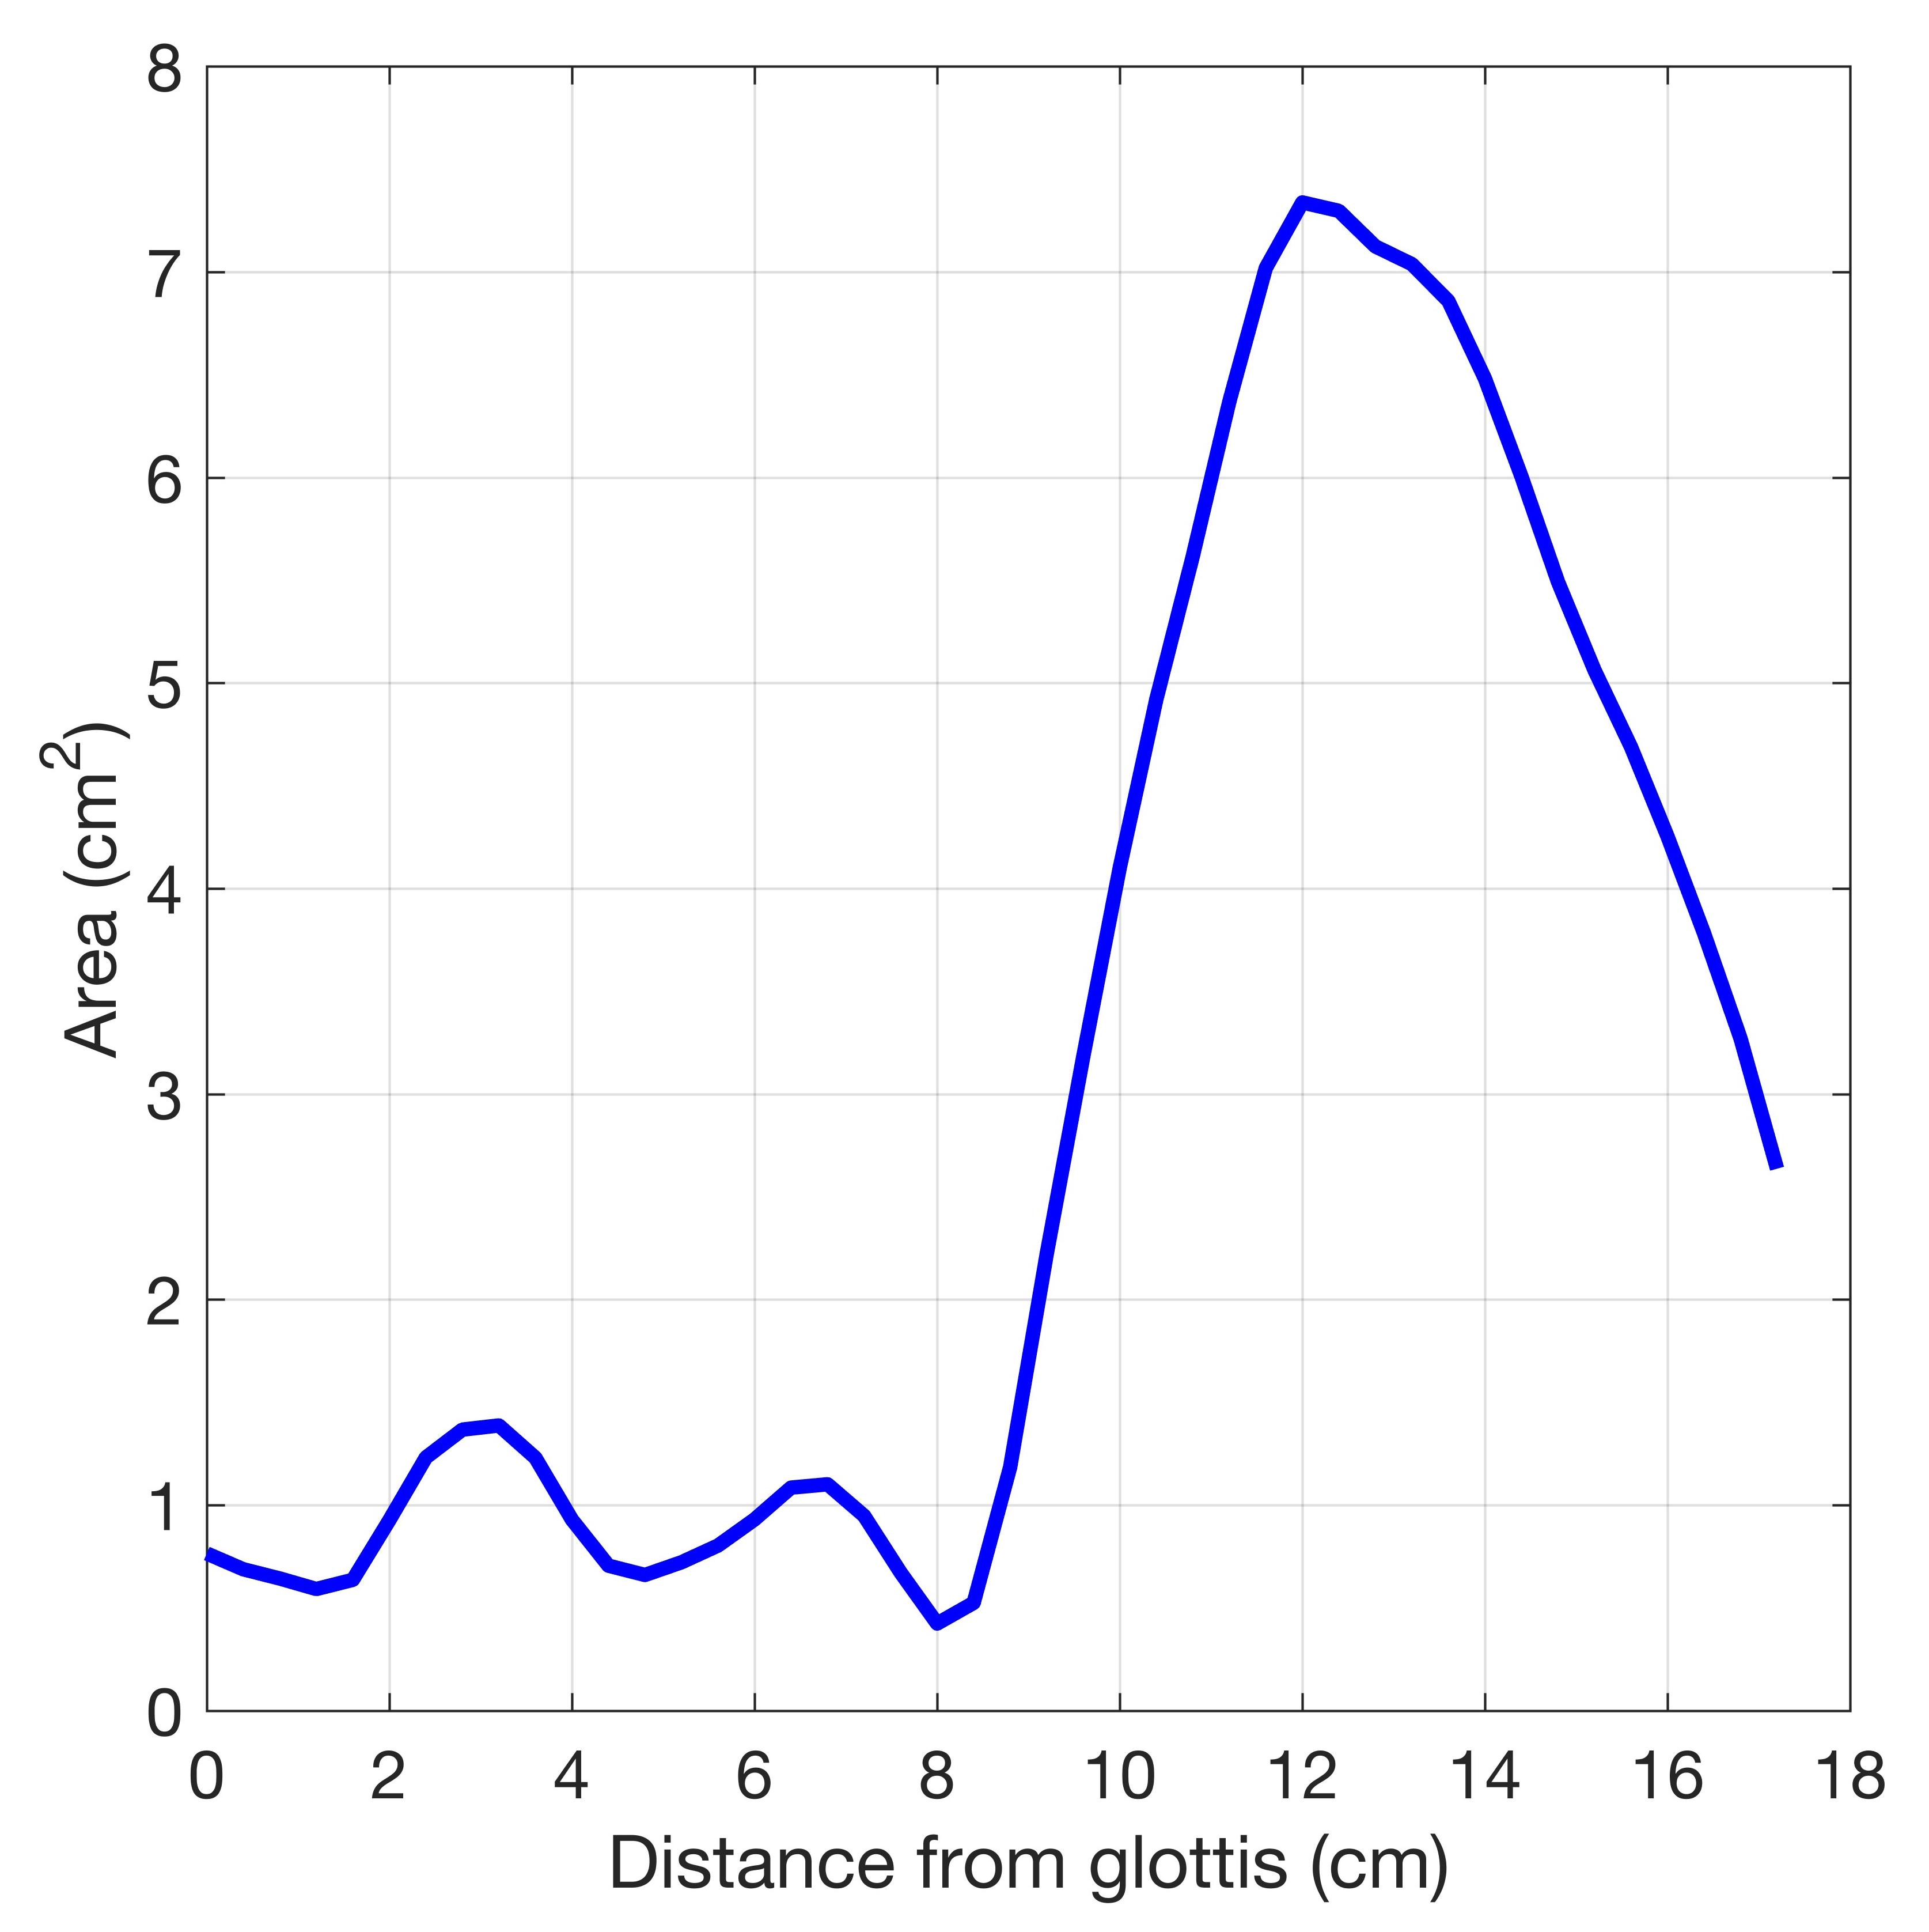
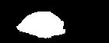
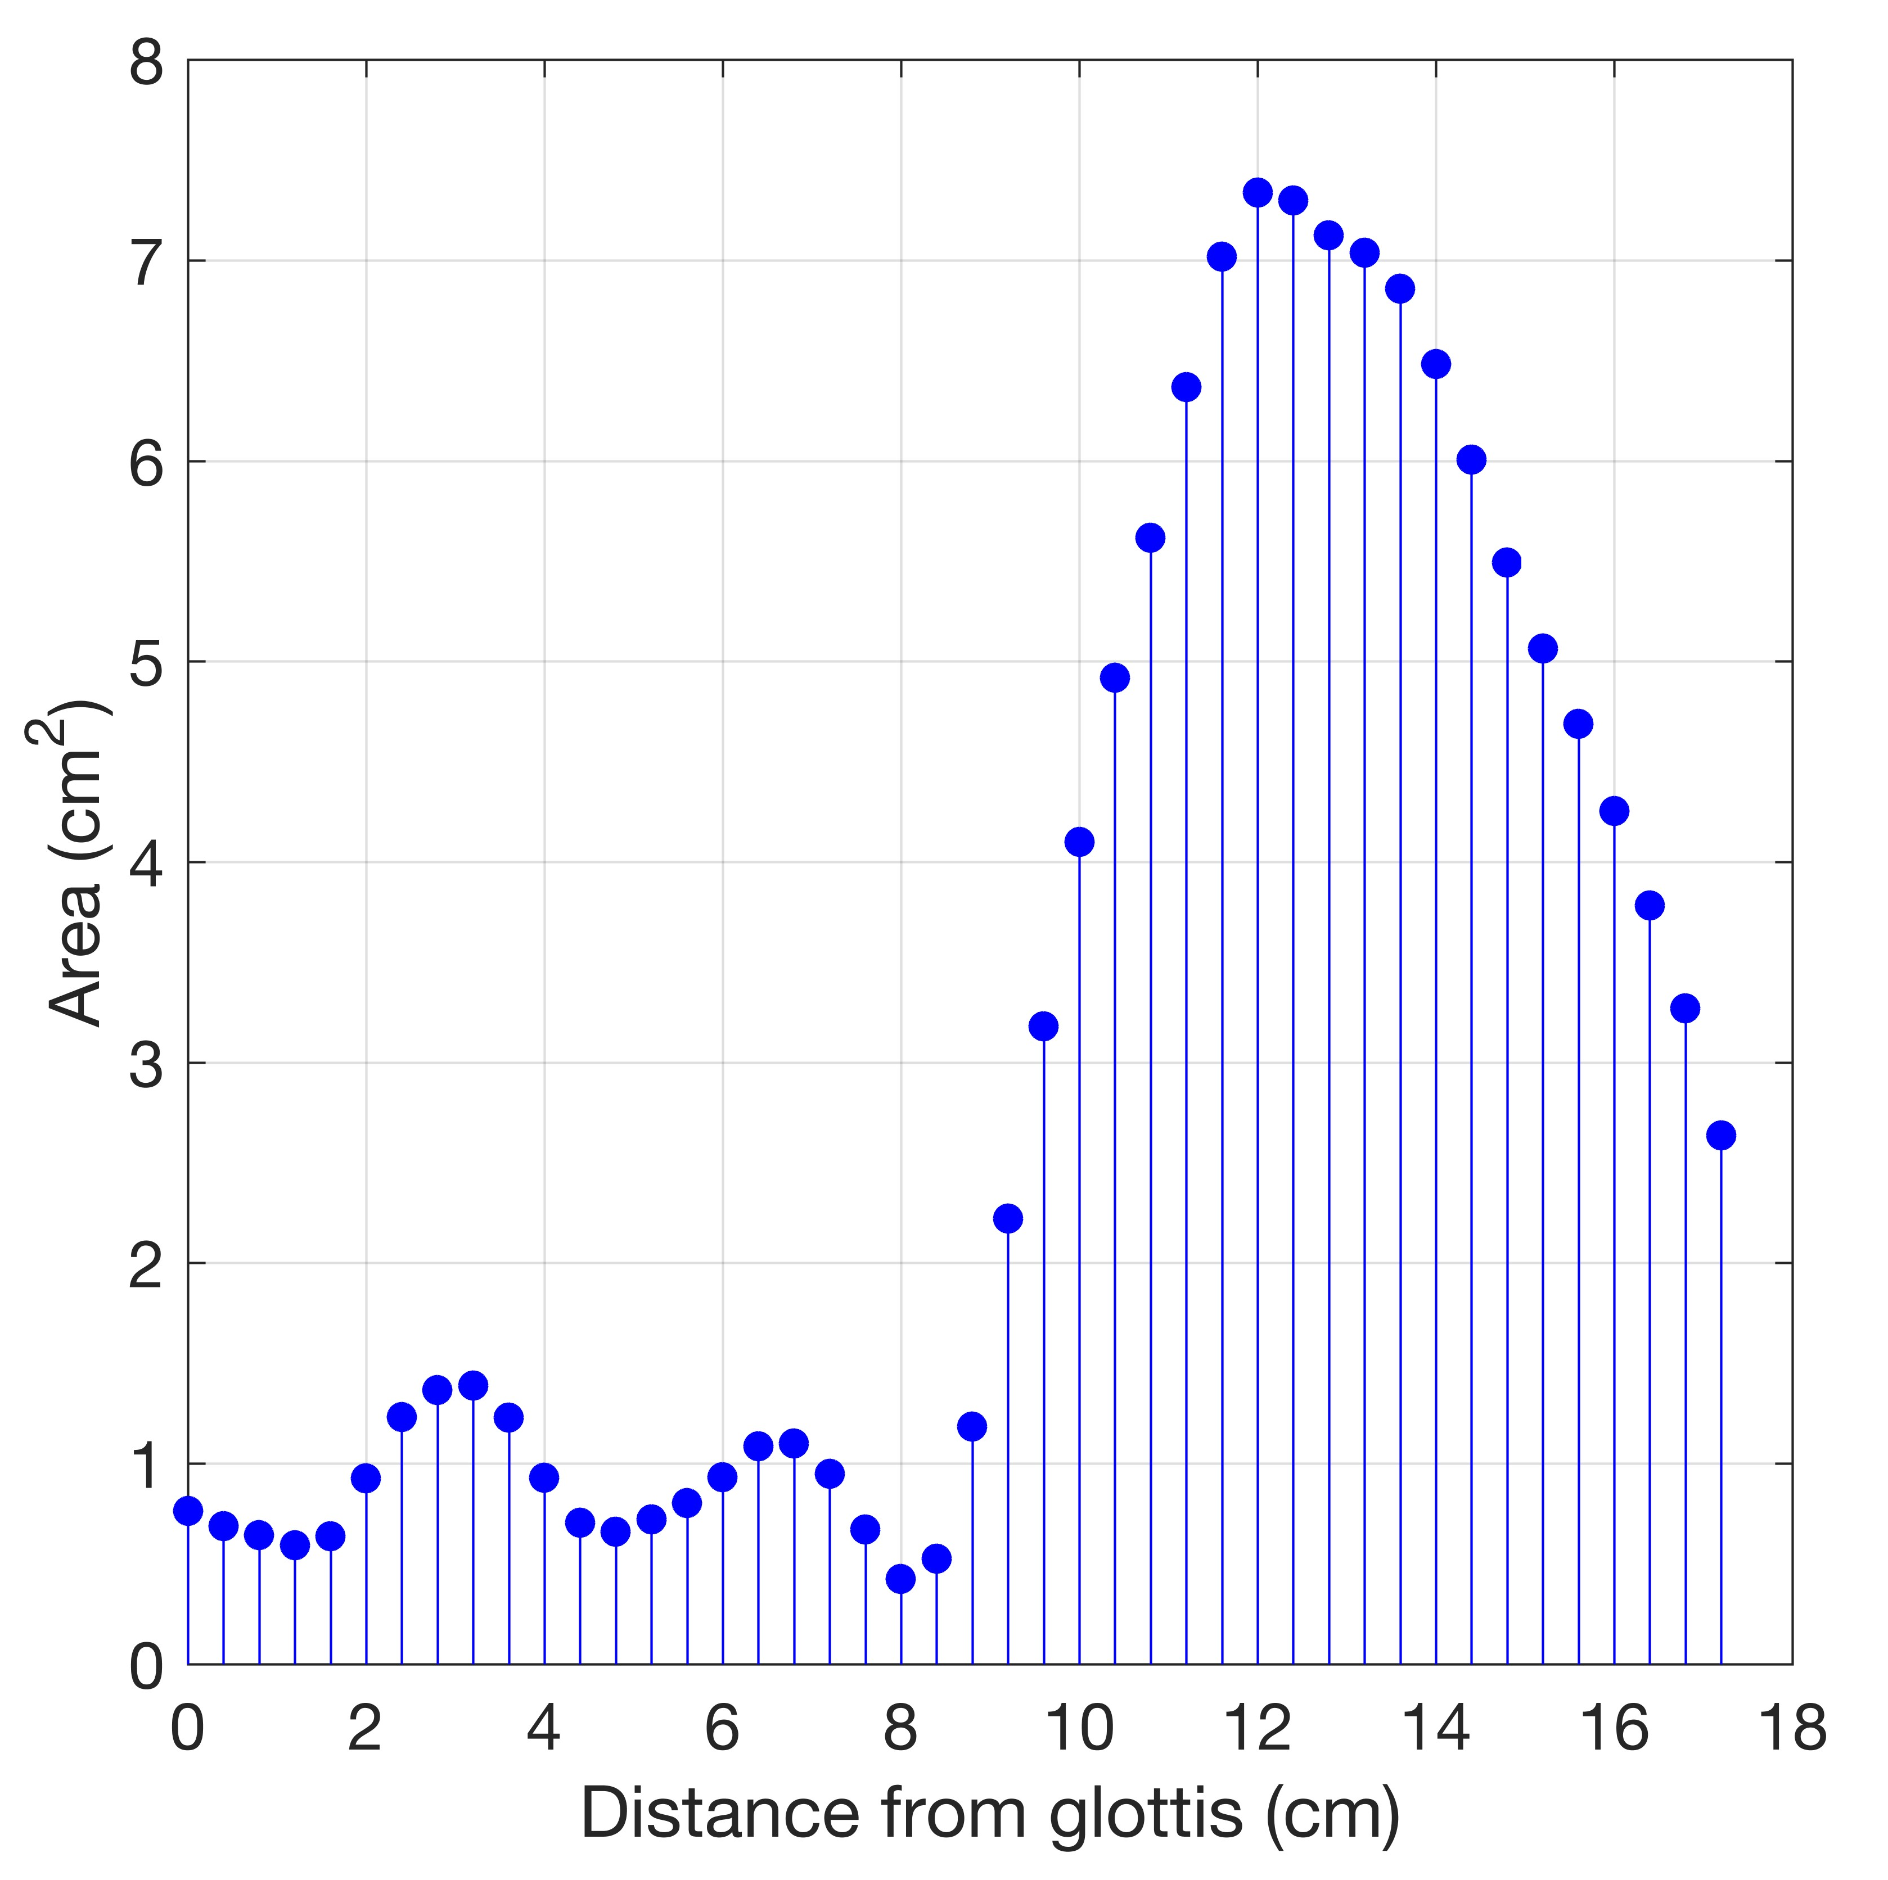
Configuration of the Vocal Tract
3-D shape
Area Function
lips
Area Function
oblique sections
oral cavity
glottis
pharynx
lips
trachea
3D reconstruction based on volumetric X-ray CT images
B. Story, Univ. Arizona

Slide 3
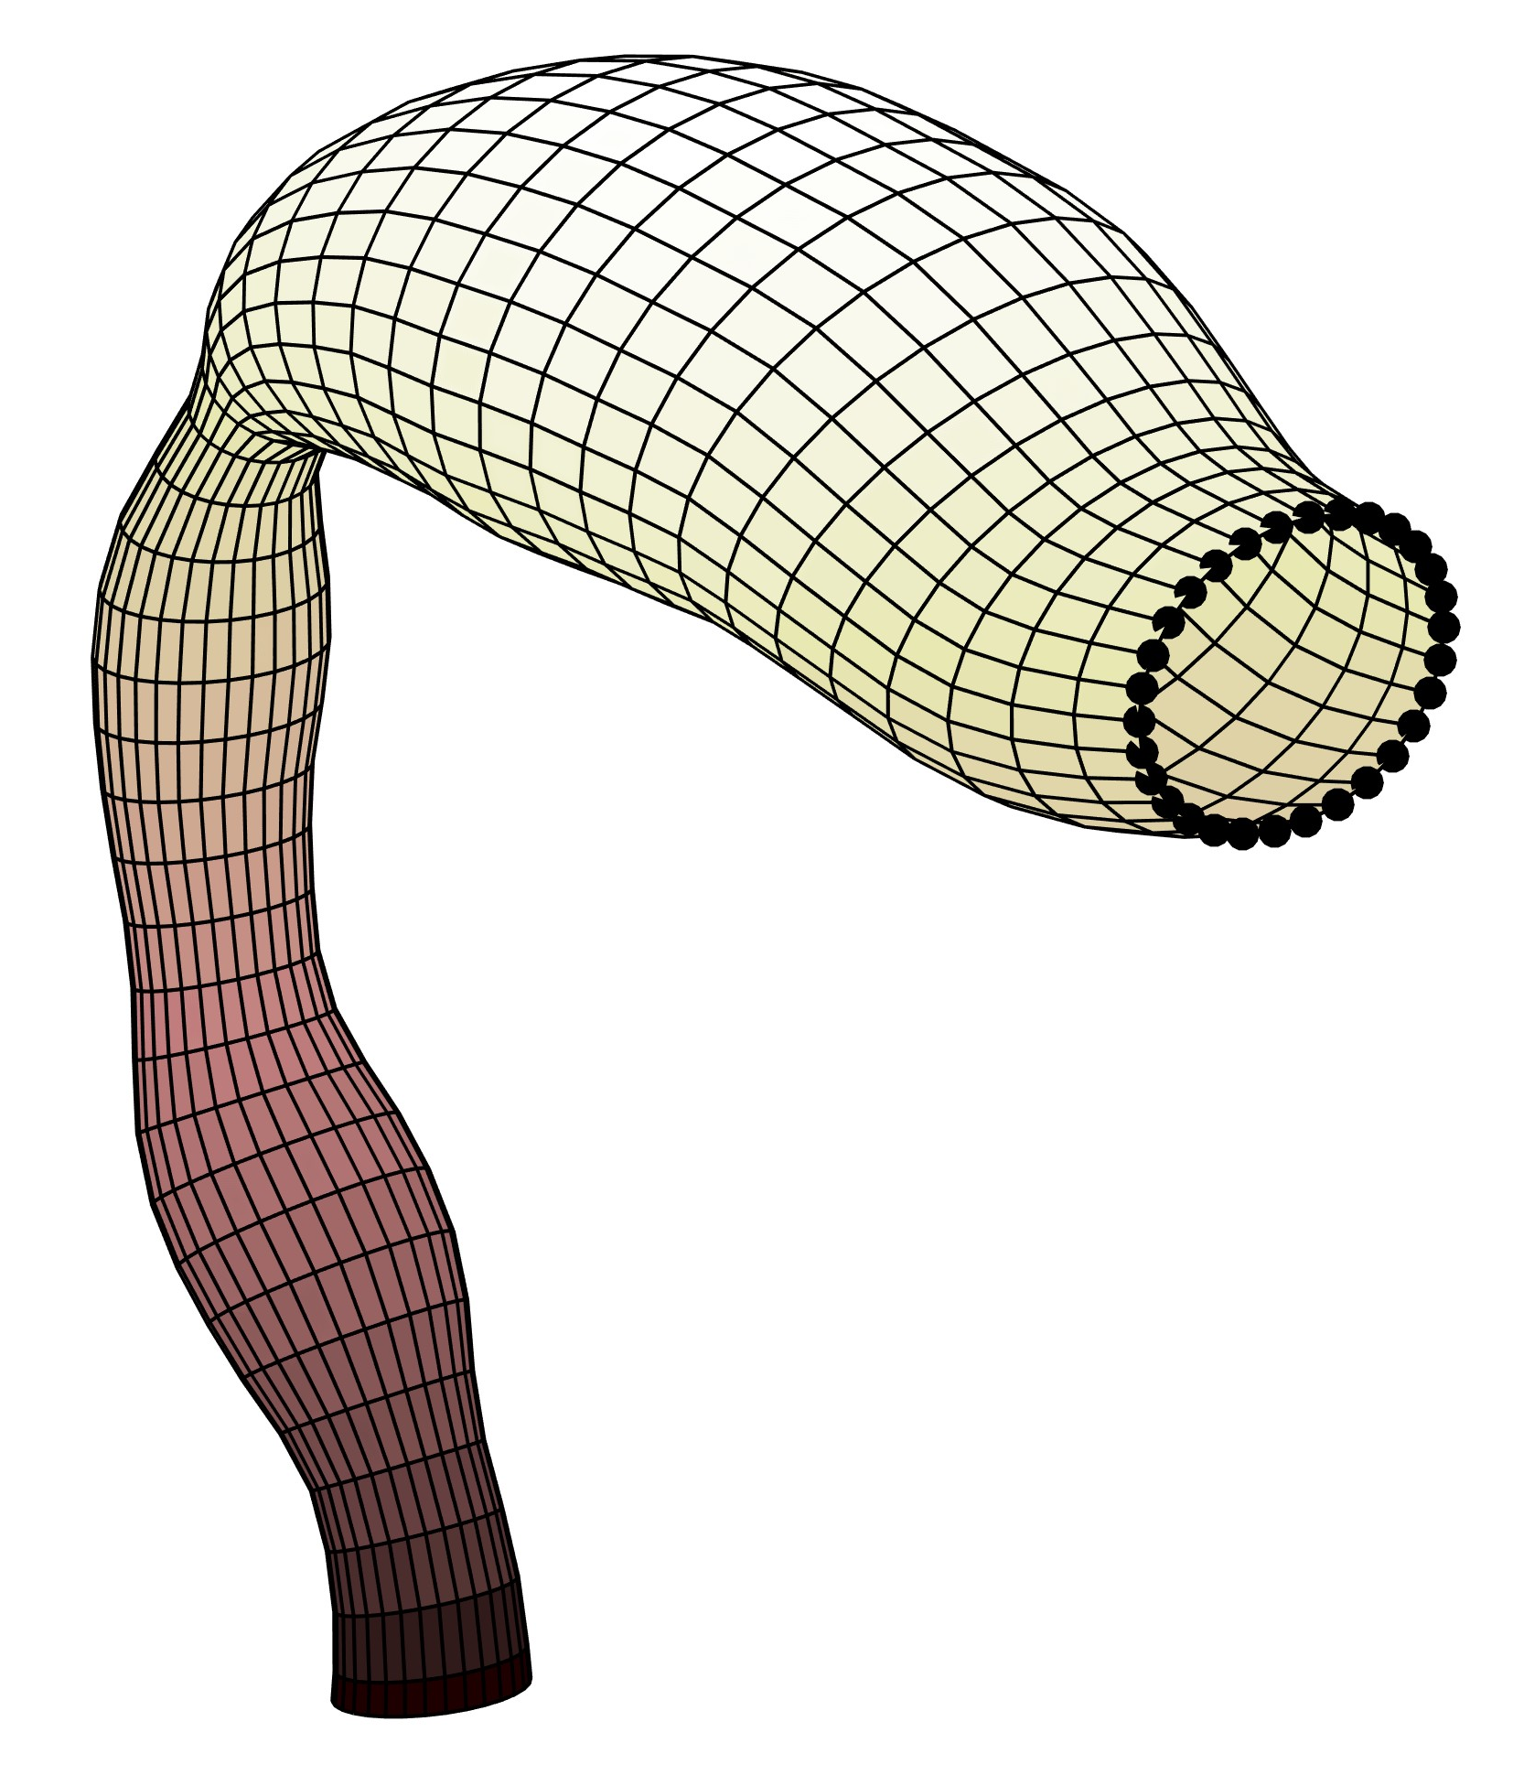
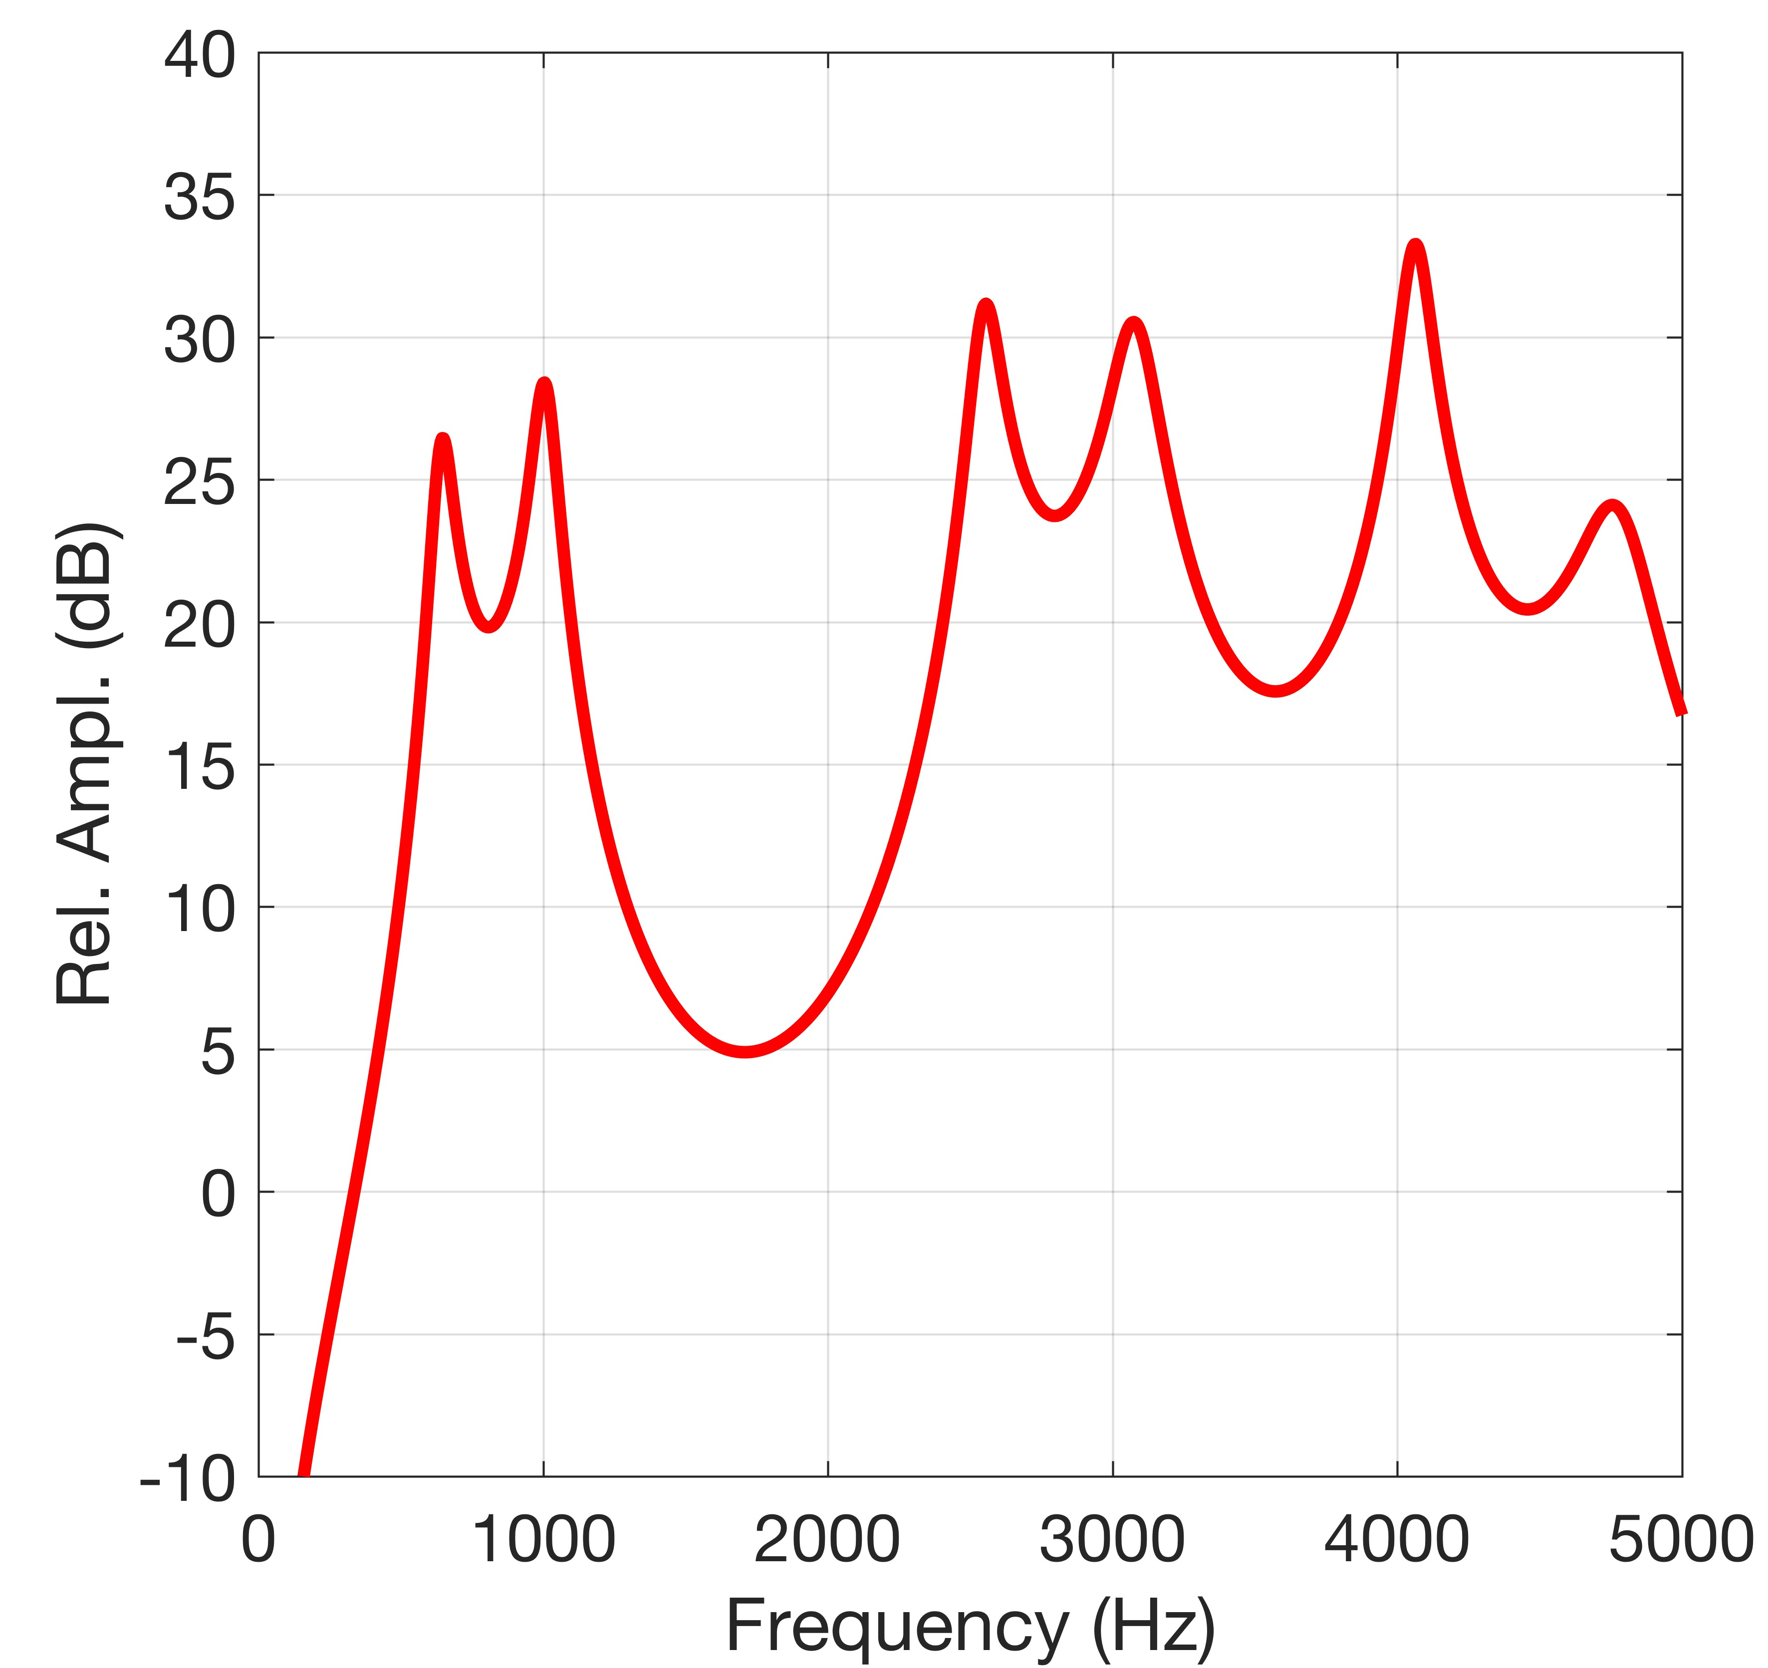
Tubular representation of the vocal tract shape
Area function configuration projected onto the anatomically-based profile
The curvature has minimal acoustic effect in the frequency range of speech
Frequency Response of the vocal tract
Resonances = vibratory modes of the airspace
B. Story, Univ. Arizona

Slide 4

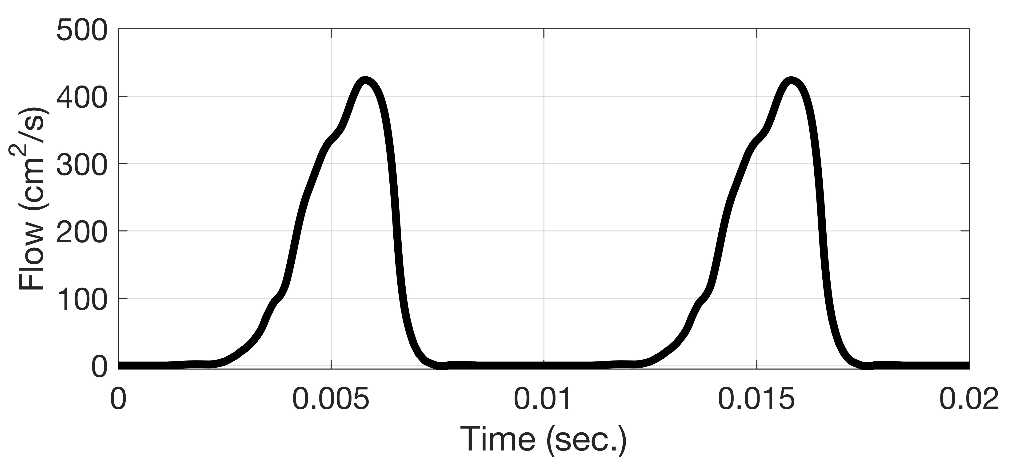
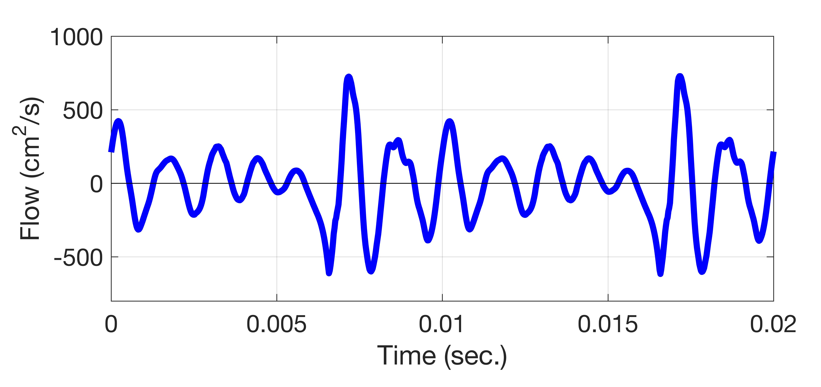
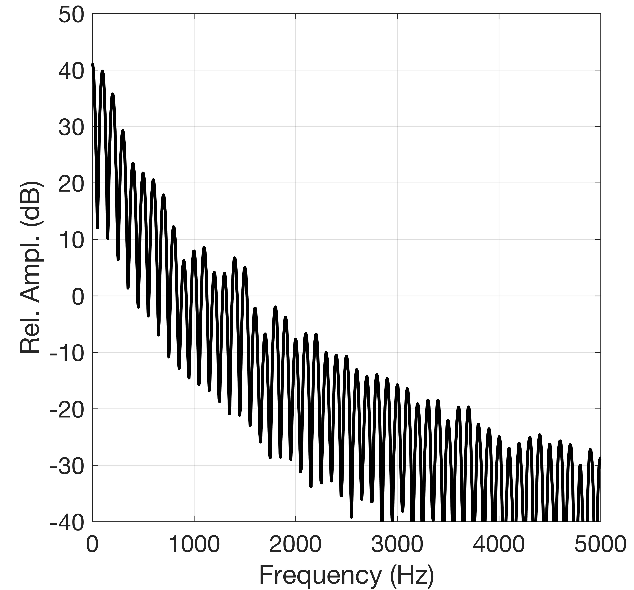
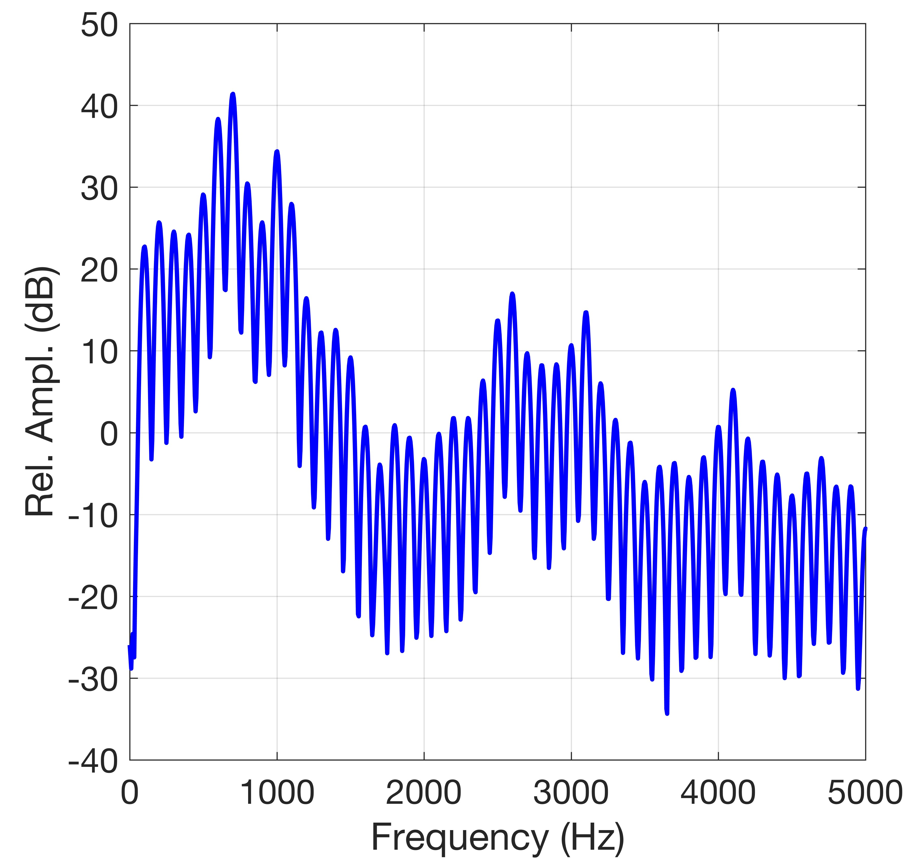
Source and Filter = Output
Every glottal flow cycle acts like an impulse that “strikes” the vocal tract
The vocal tract responds much like a bell
Peaks in the spectral envelope are the formants
Peaks are resonances of the vocal tract
B. Story, Univ. Arizona

Slide 5
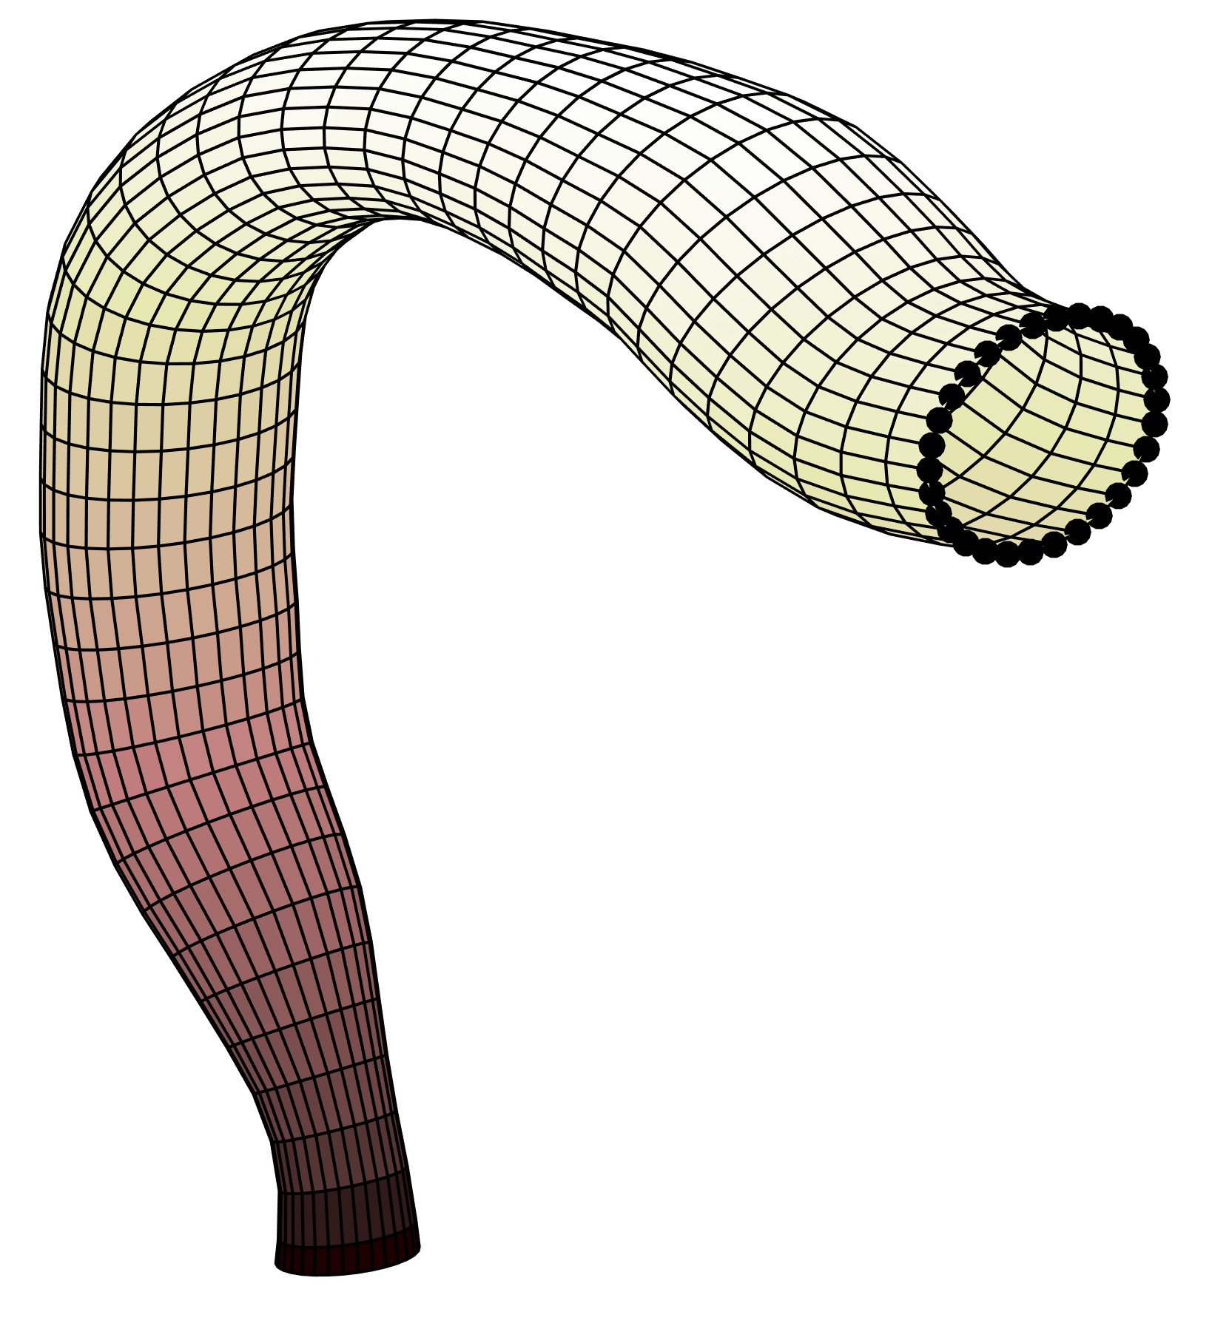
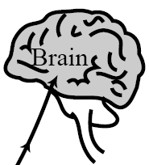
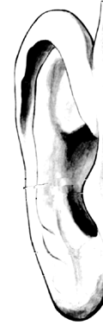
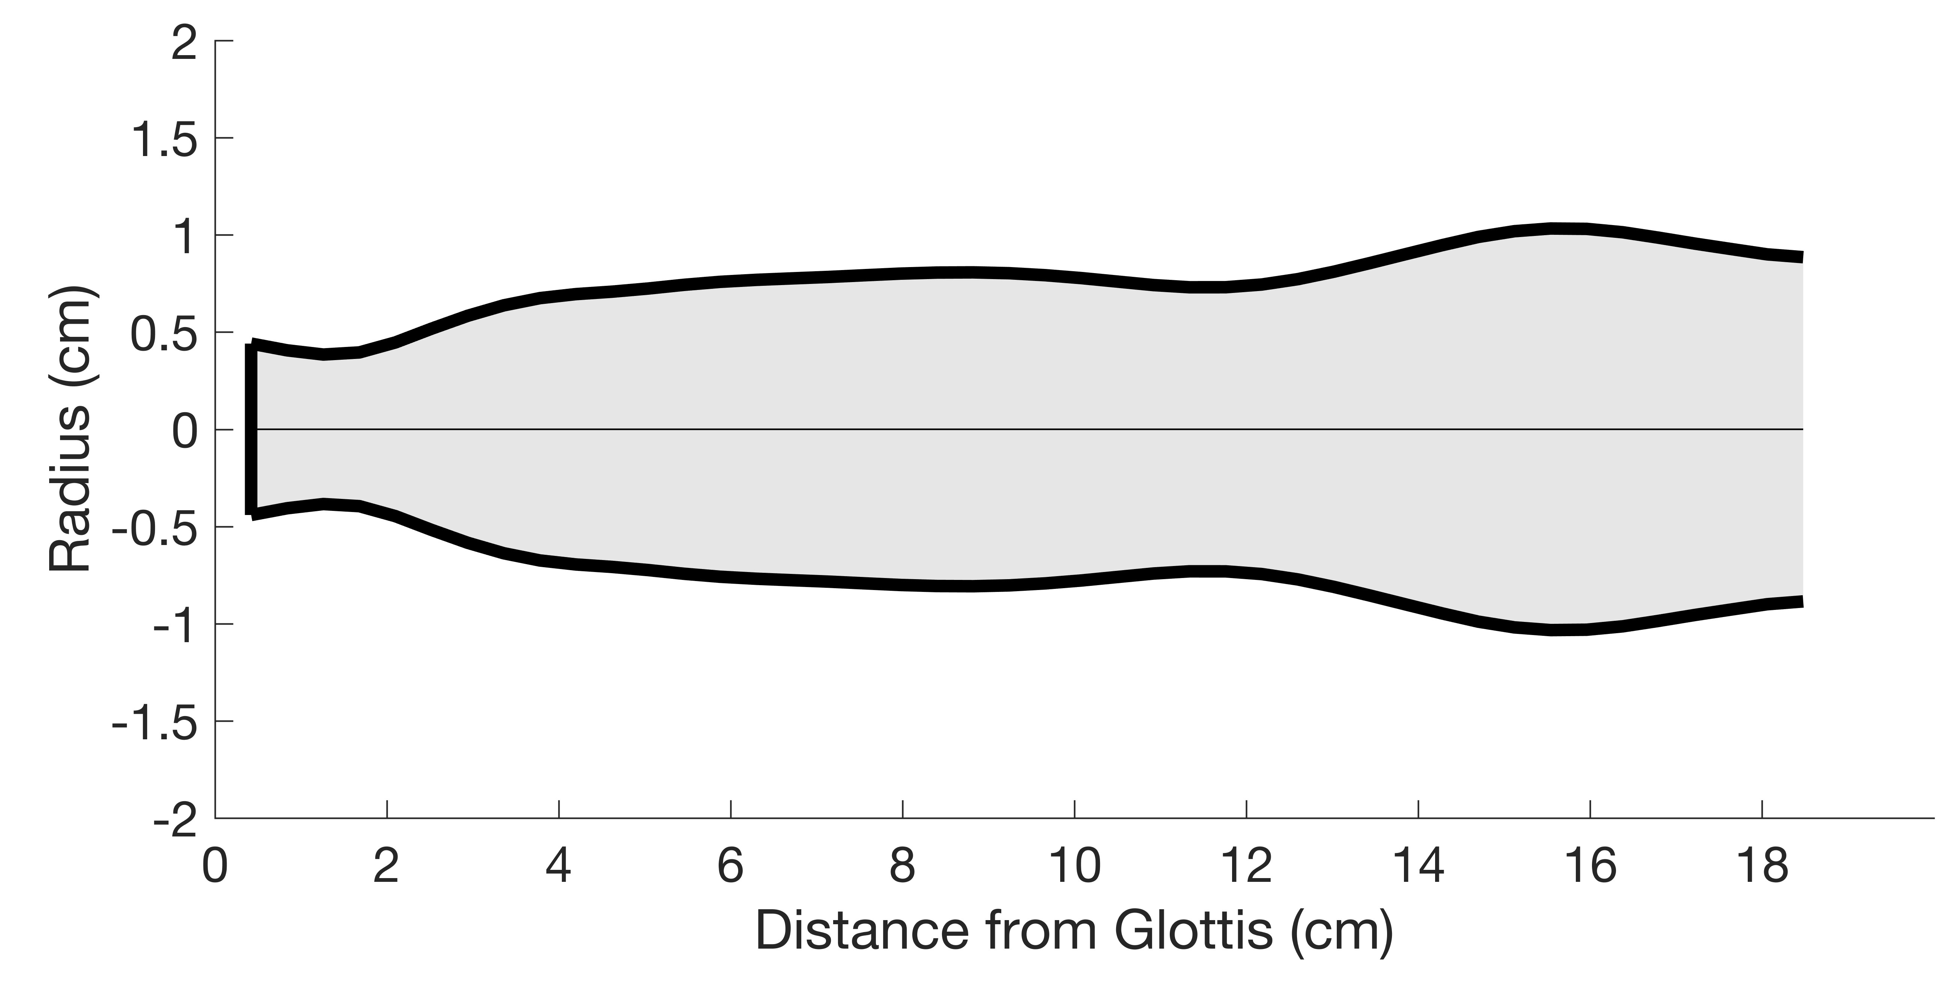
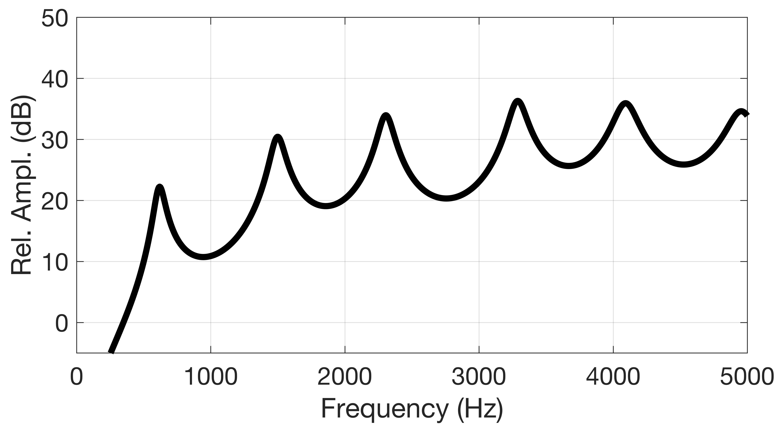
“Carving” the vocal tract shape
Acoustic sensitivity is the difference of kinetic and potential energy normalized by the total energy.
Begin with a “neutral” tract configuration
B. Story, Univ. Arizona

Slide 6
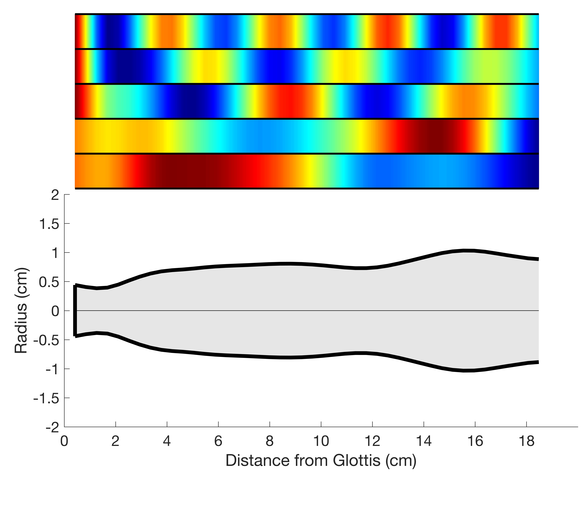
Acoustic sensitivity functions of the neutral VT shape
B. Story, Univ. Arizona
*Expansions have the opposite effect

Slide 7
Acoustic sensitivity functions of the neutral VT shape
B. Story, Univ. Arizona
*Expansions have the opposite effect

Slide 8
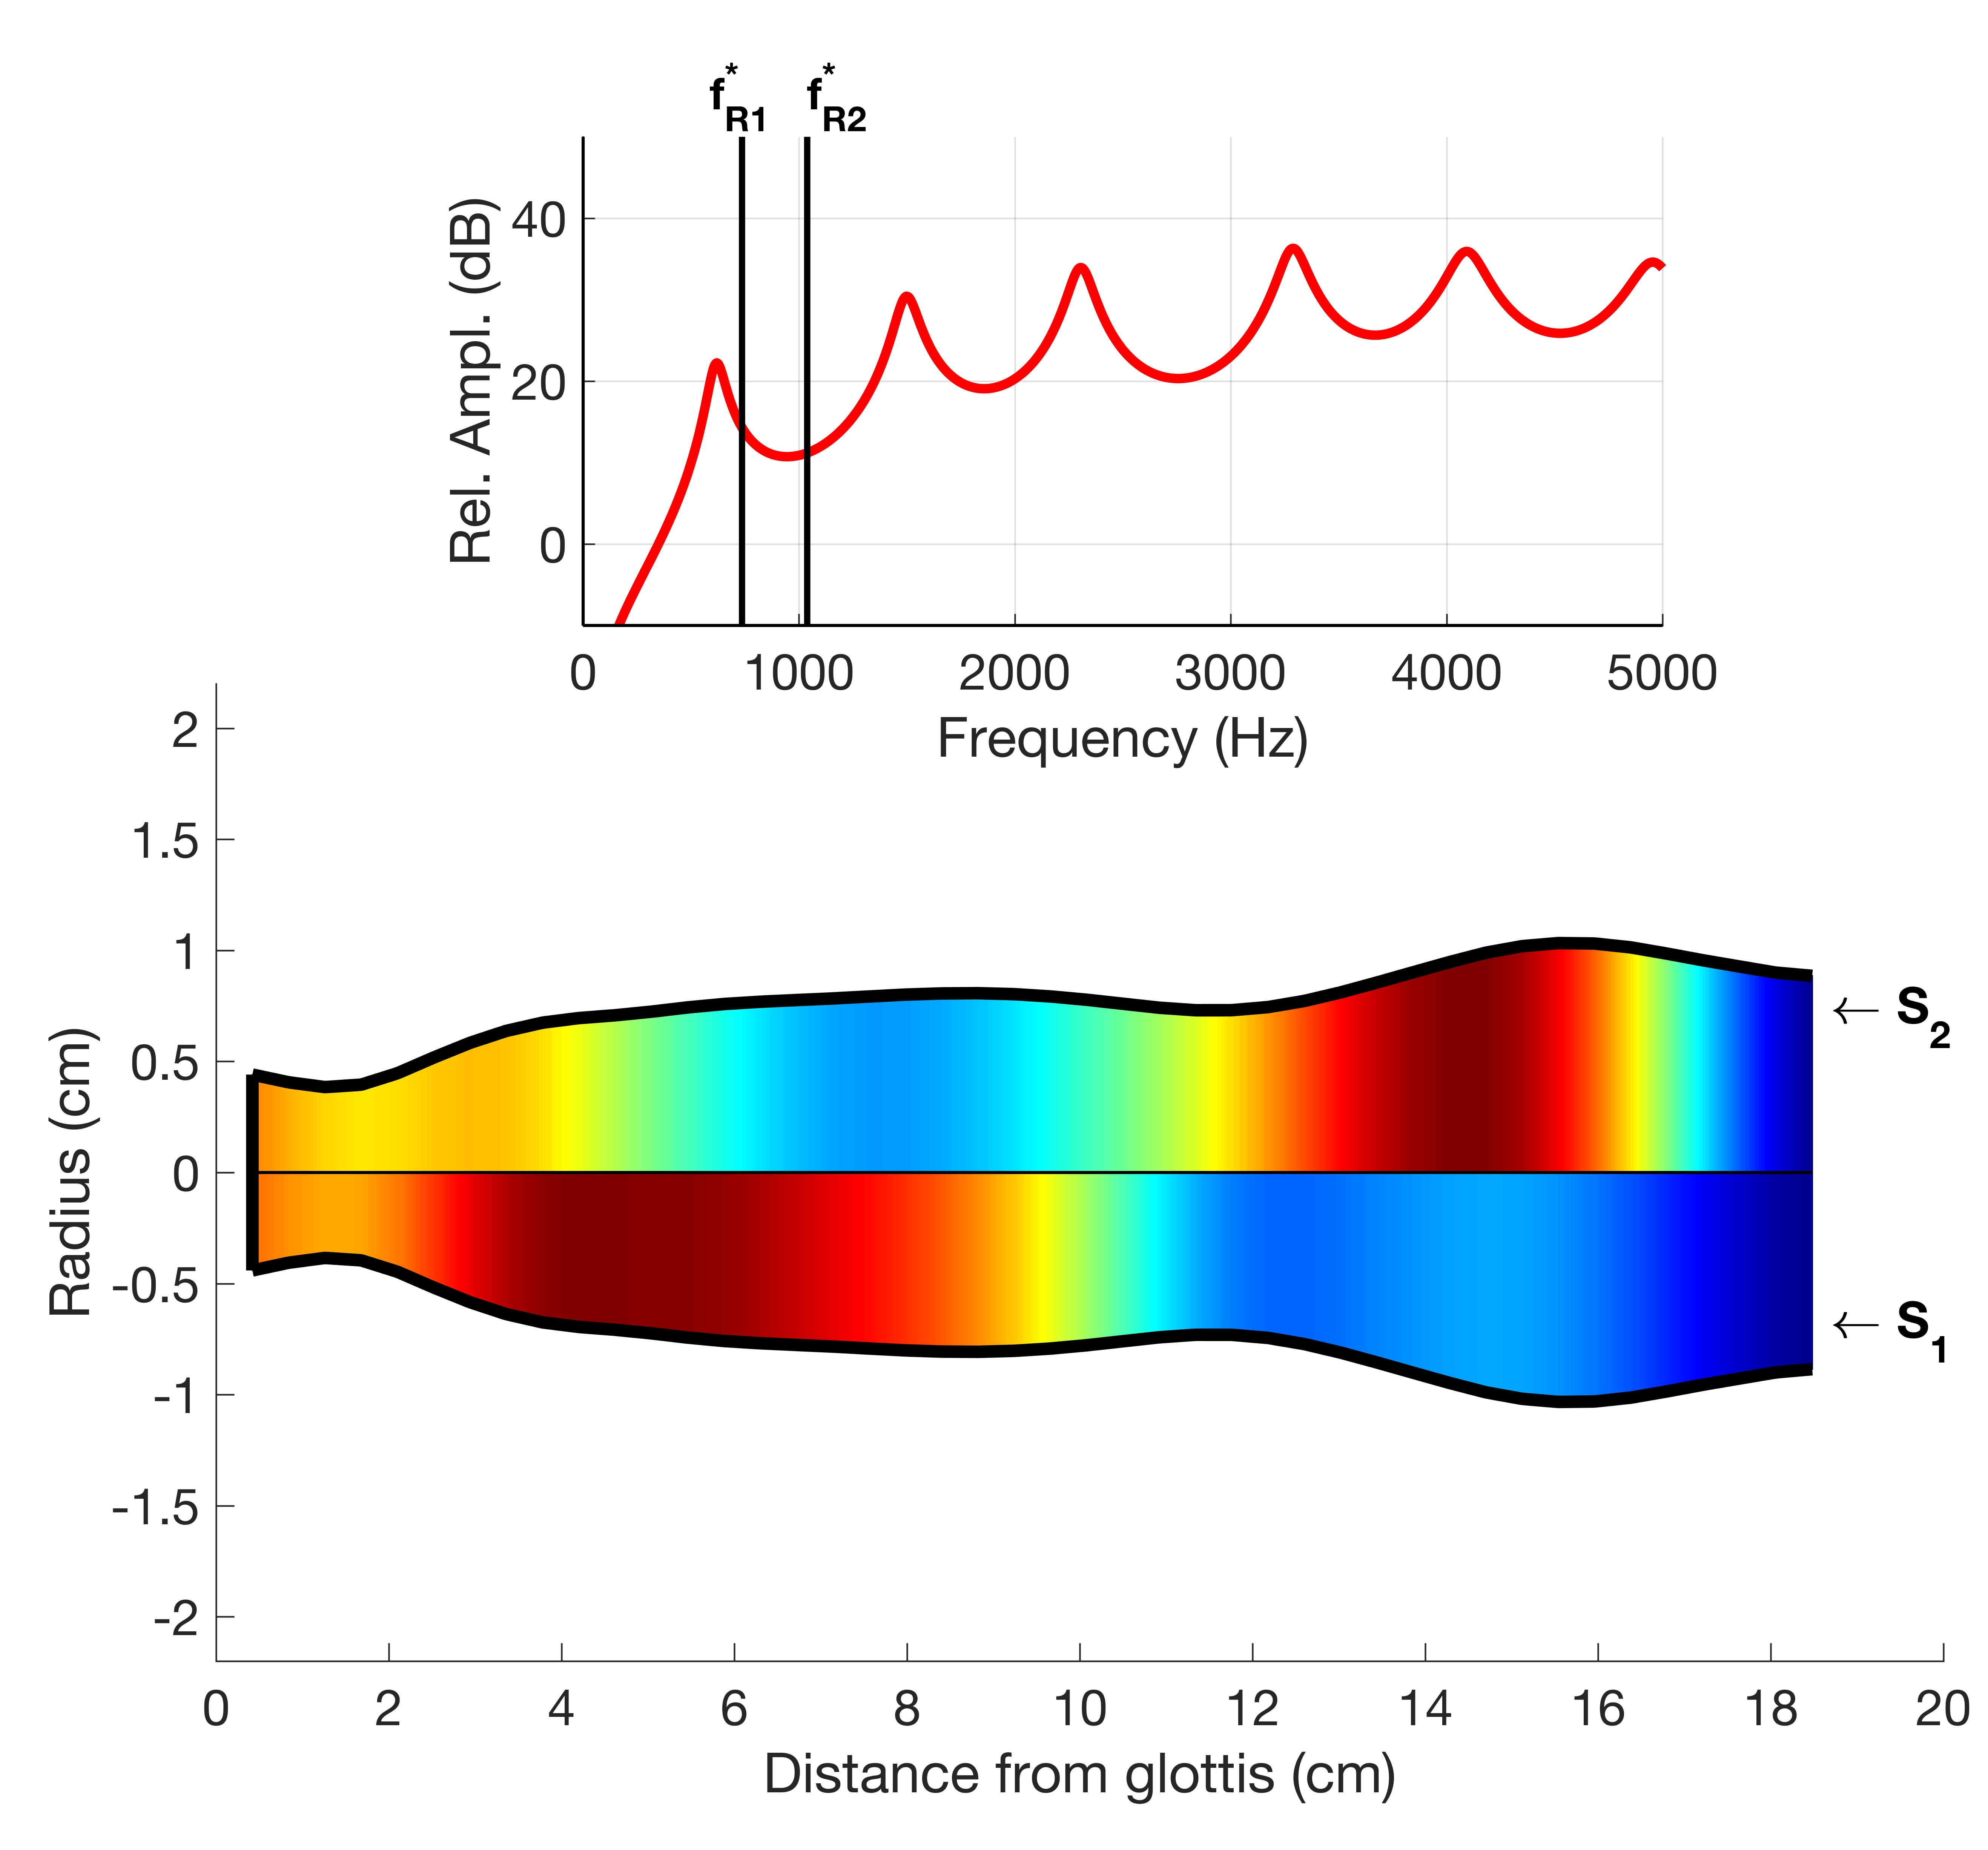
Target resonance frequencies
Frequency response
S₁ and S₂ sensitivity functions superimposed on VT shape
B. Story, Univ. Arizona

Slide 9

Target resonance frequencies
B. Story, Univ. Arizona

Slide 10
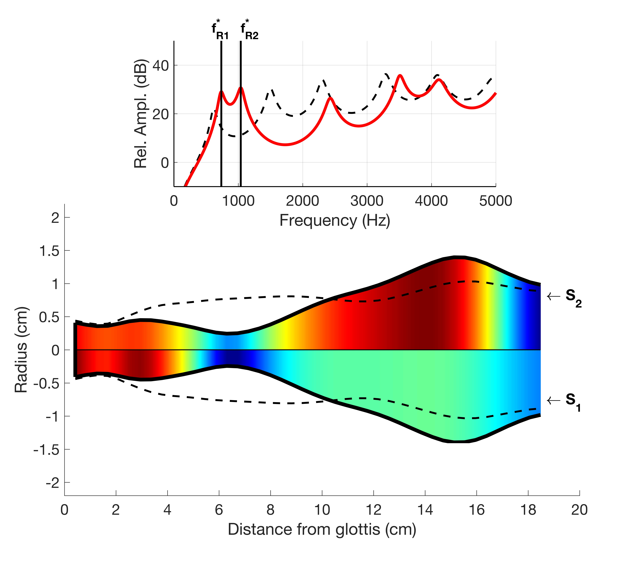
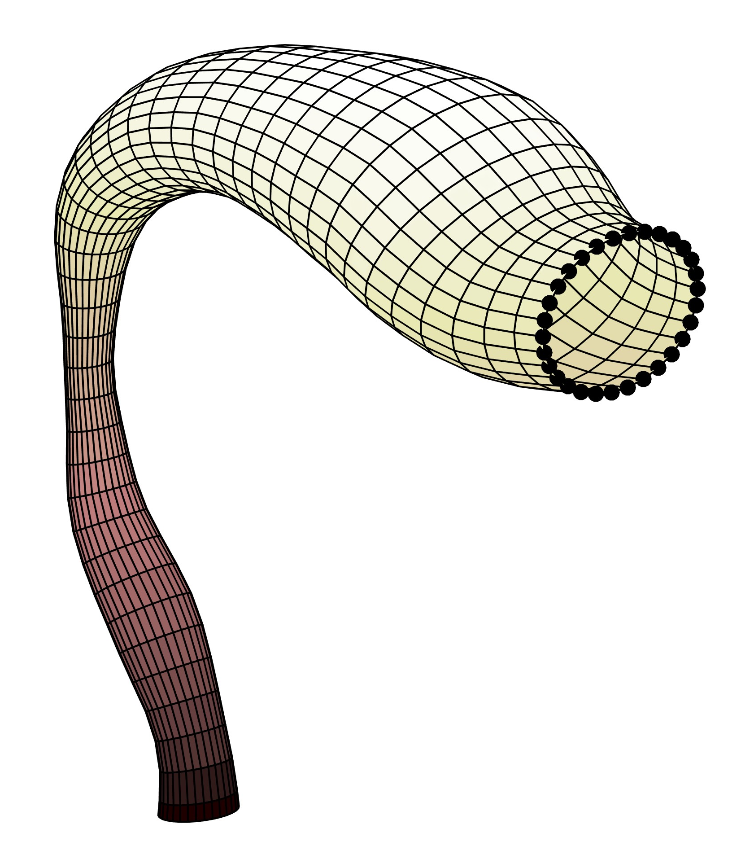
VT1
B. Story, Univ. Arizona

Slide 11
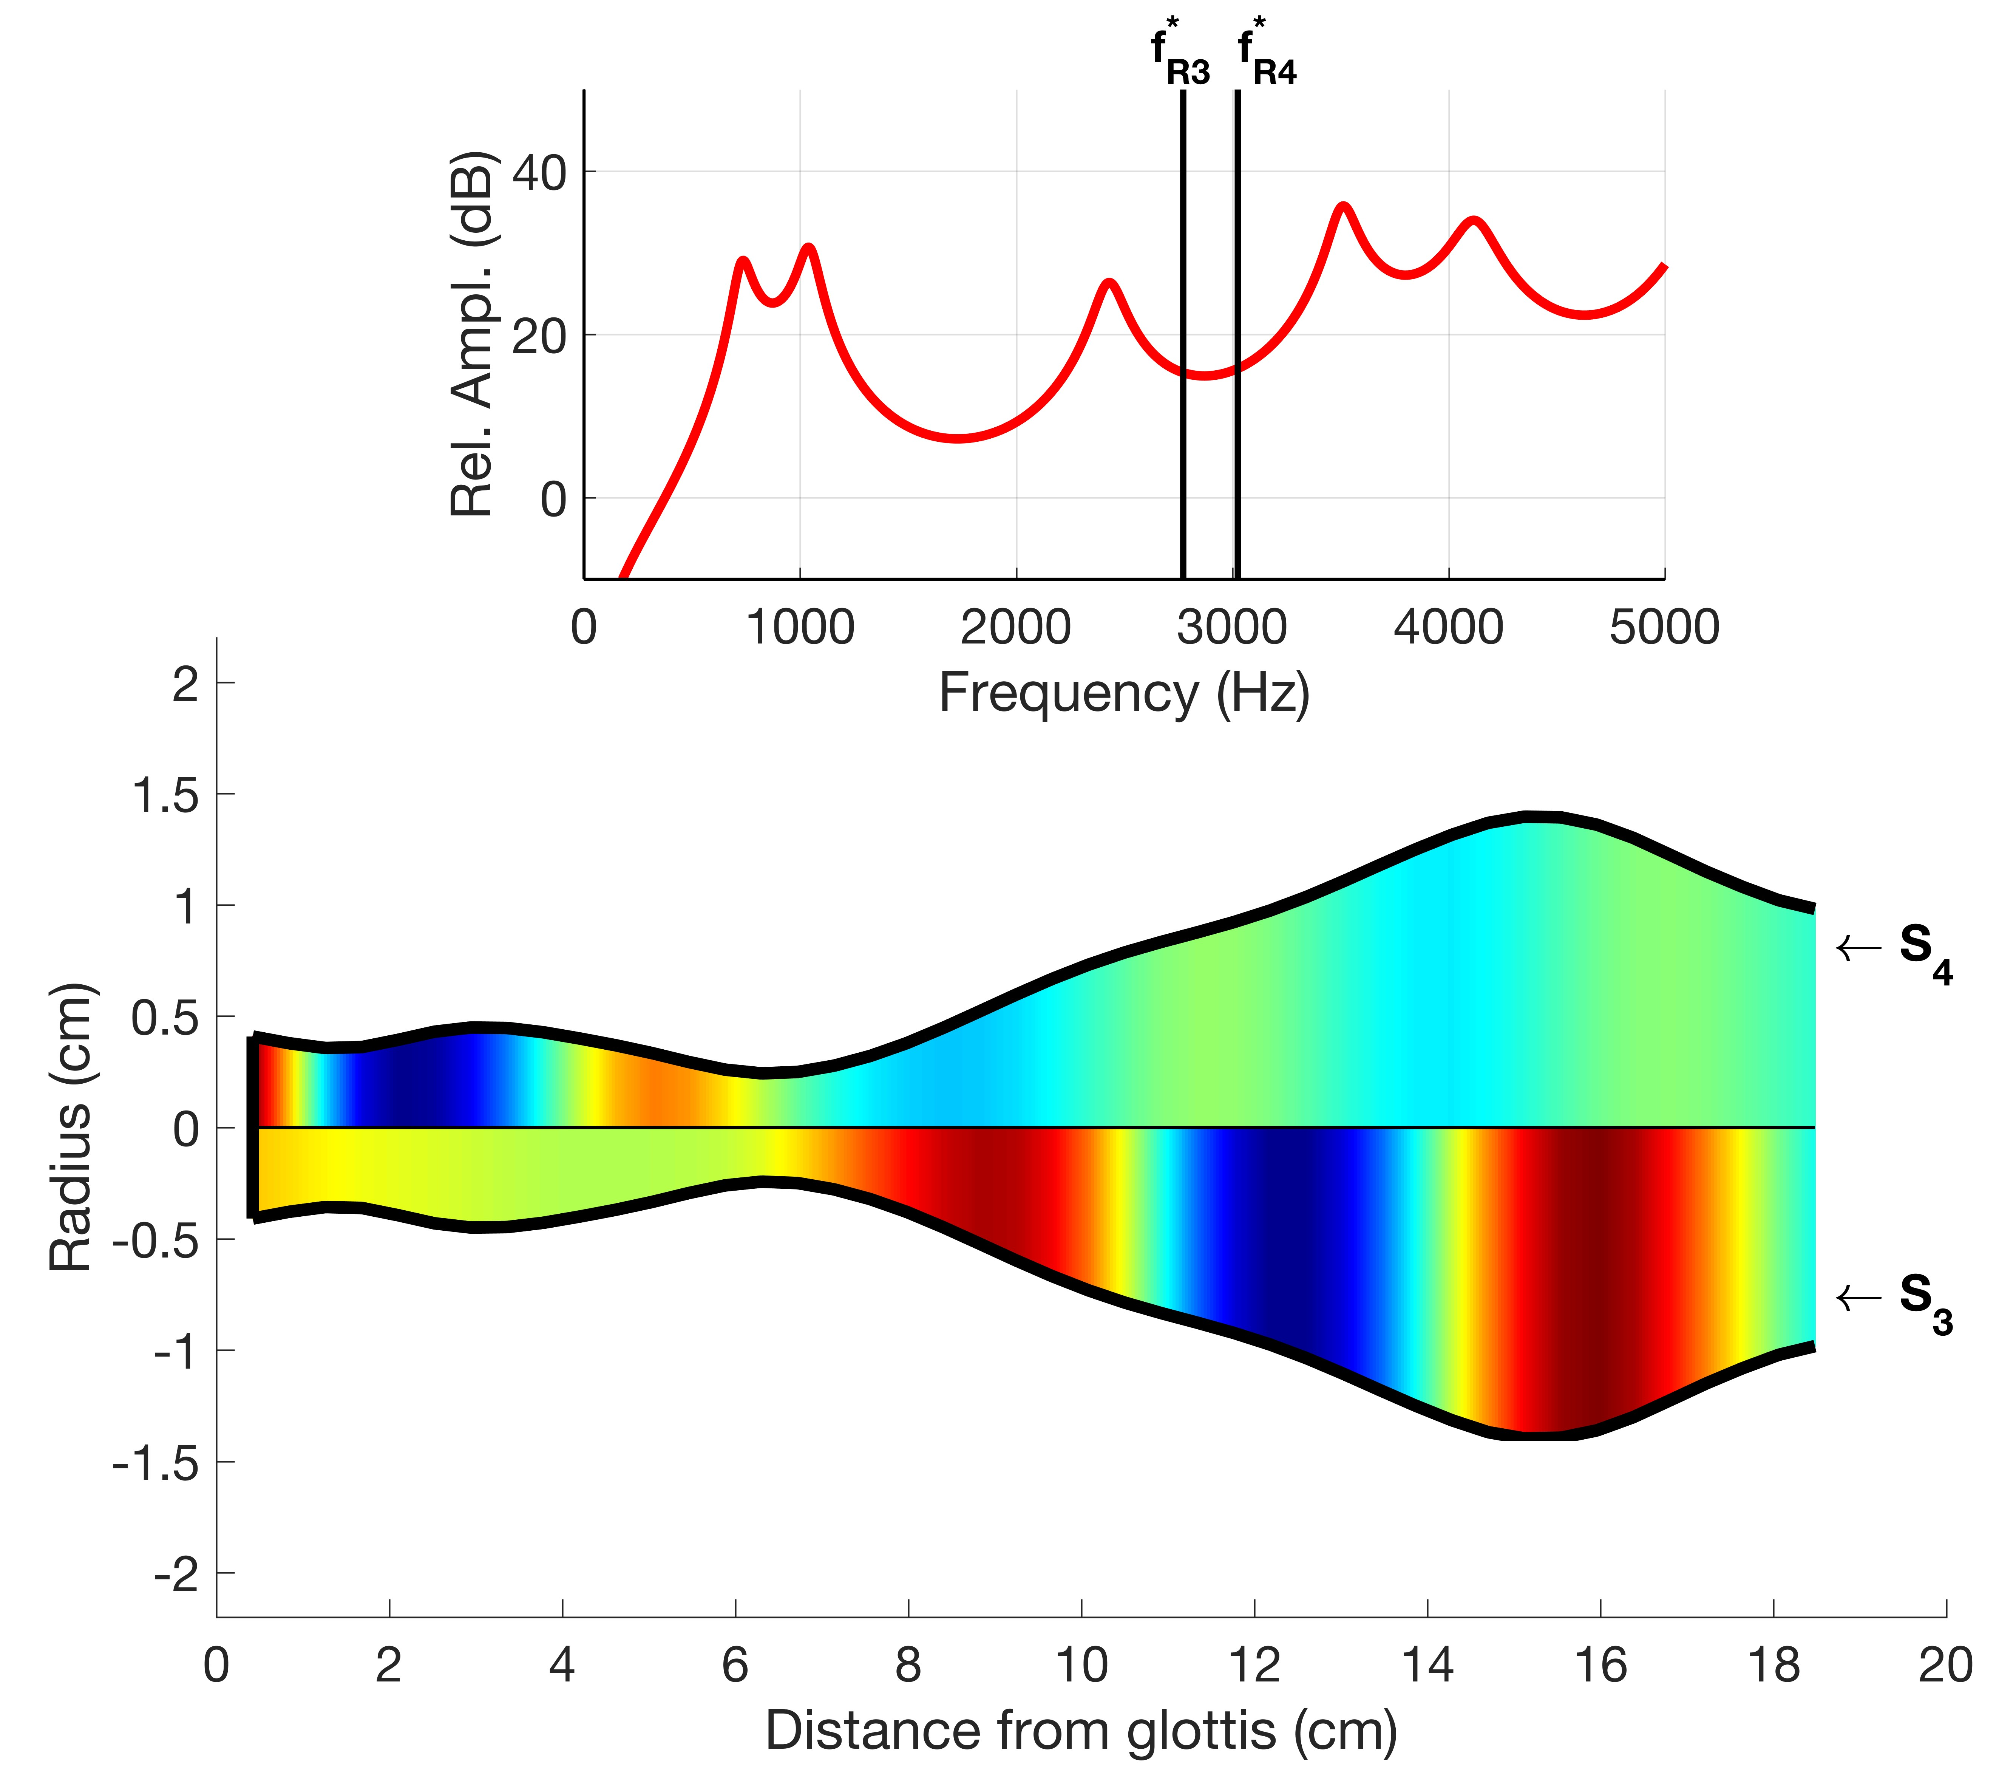
Now focus on the upper resonances
Target resonance frequencies
S₃ and S₄ sensitivity functions superimposed on VT shape
B. Story, Univ. Arizona

Slide 12

VT2
B. Story, Univ. Arizona

Slide 13
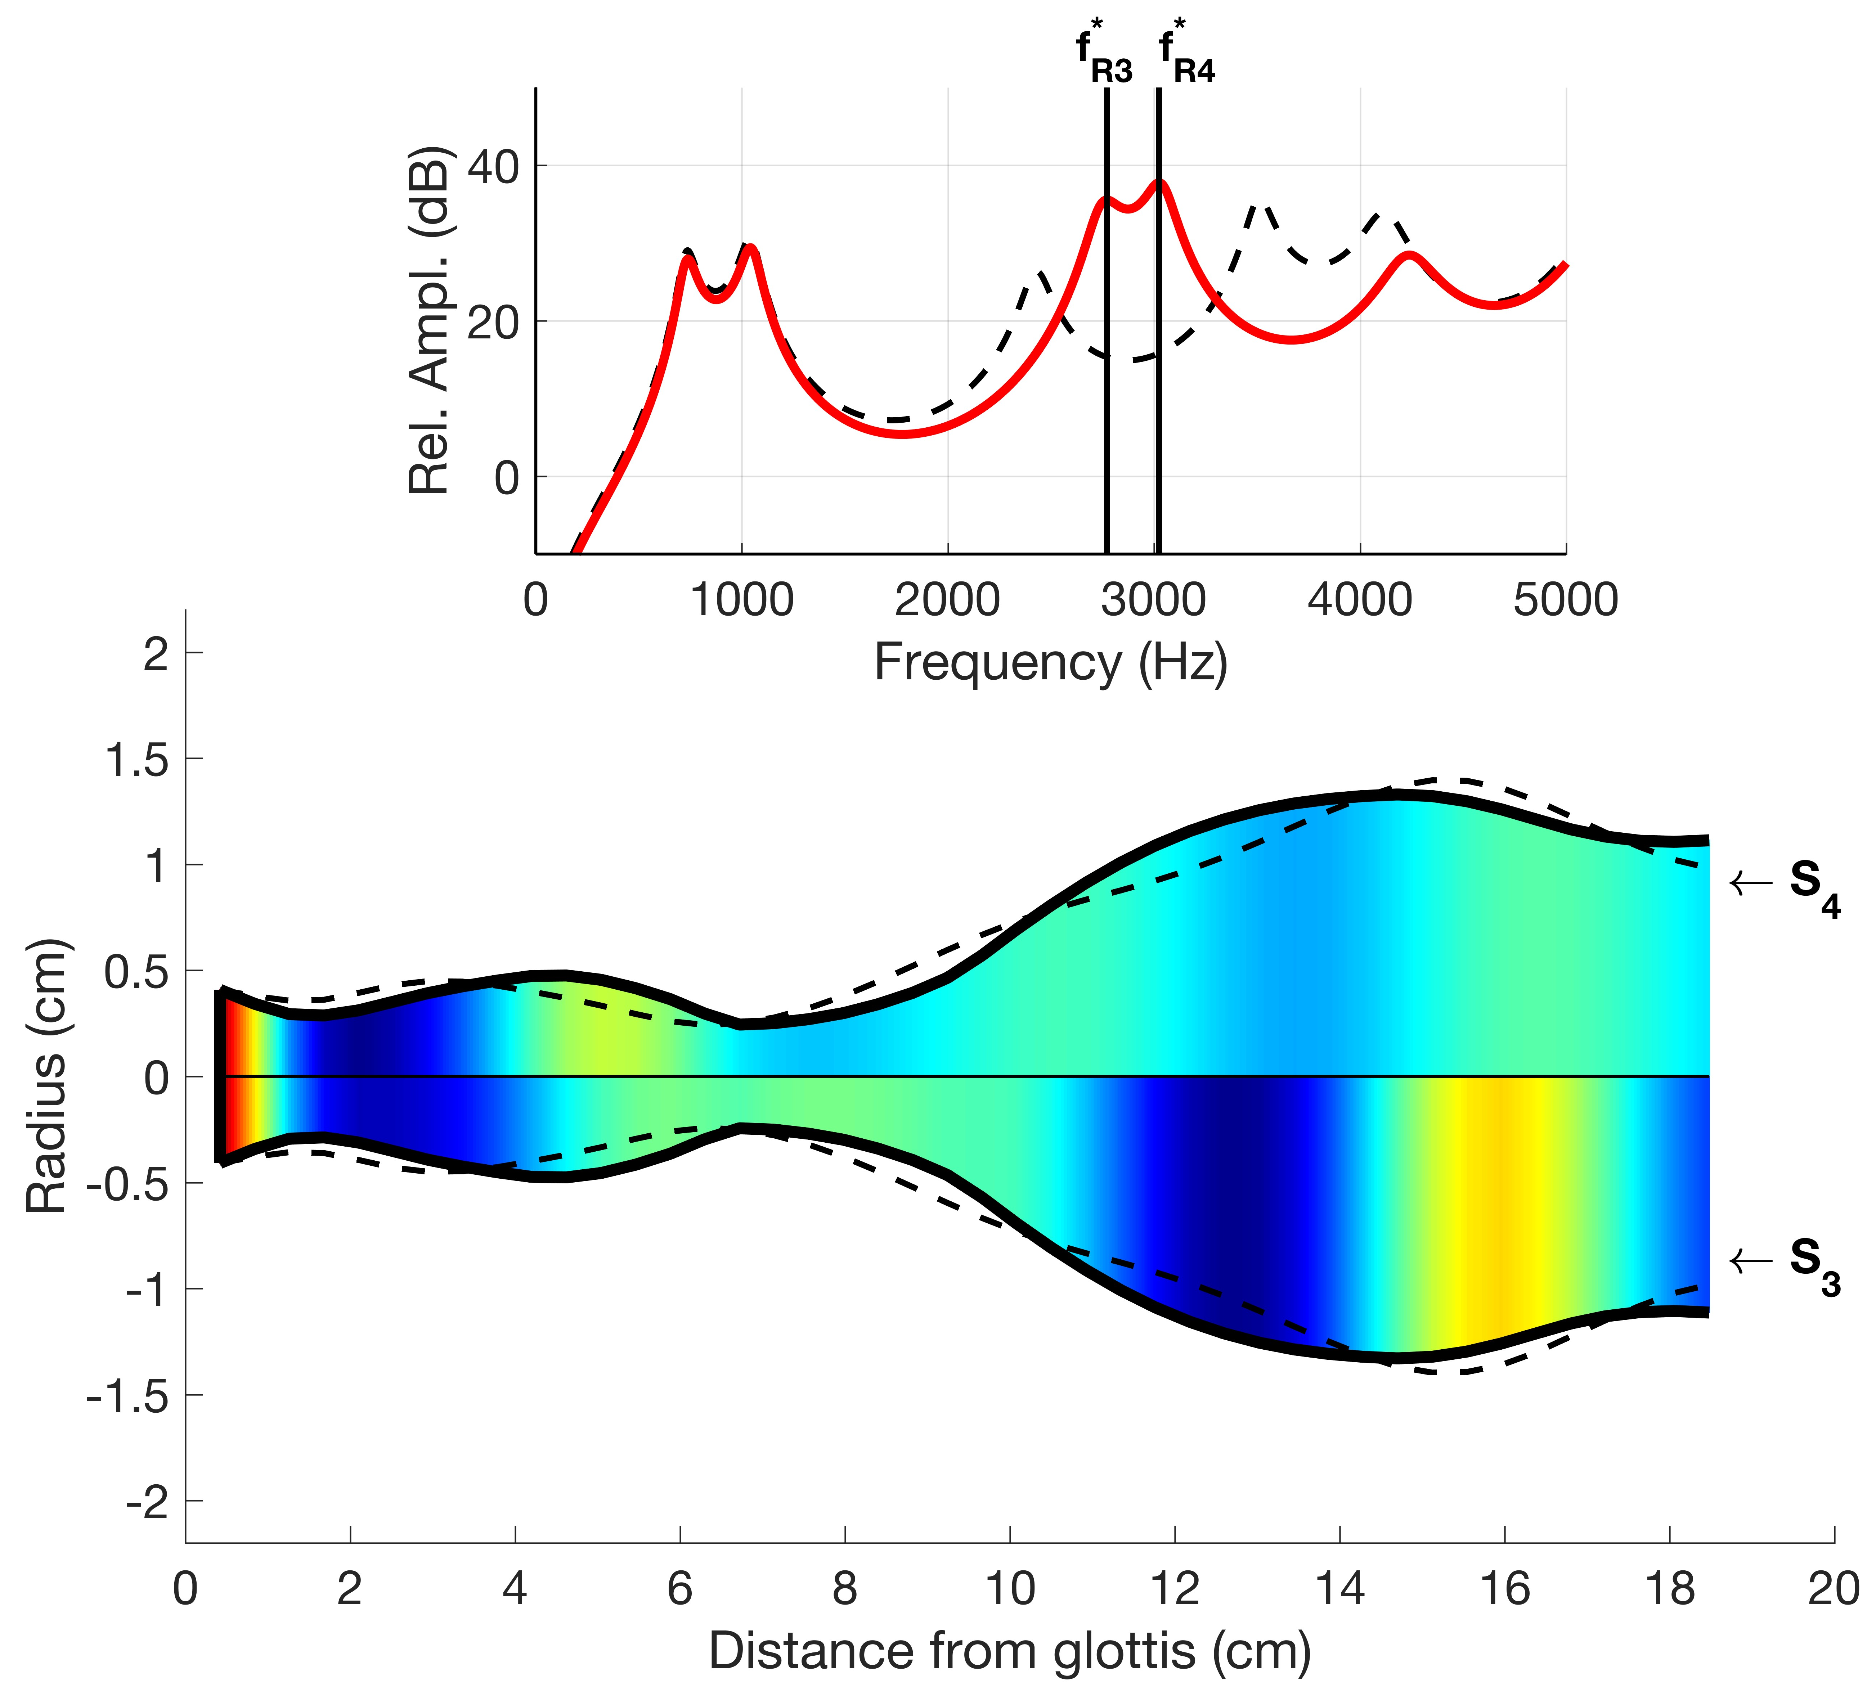
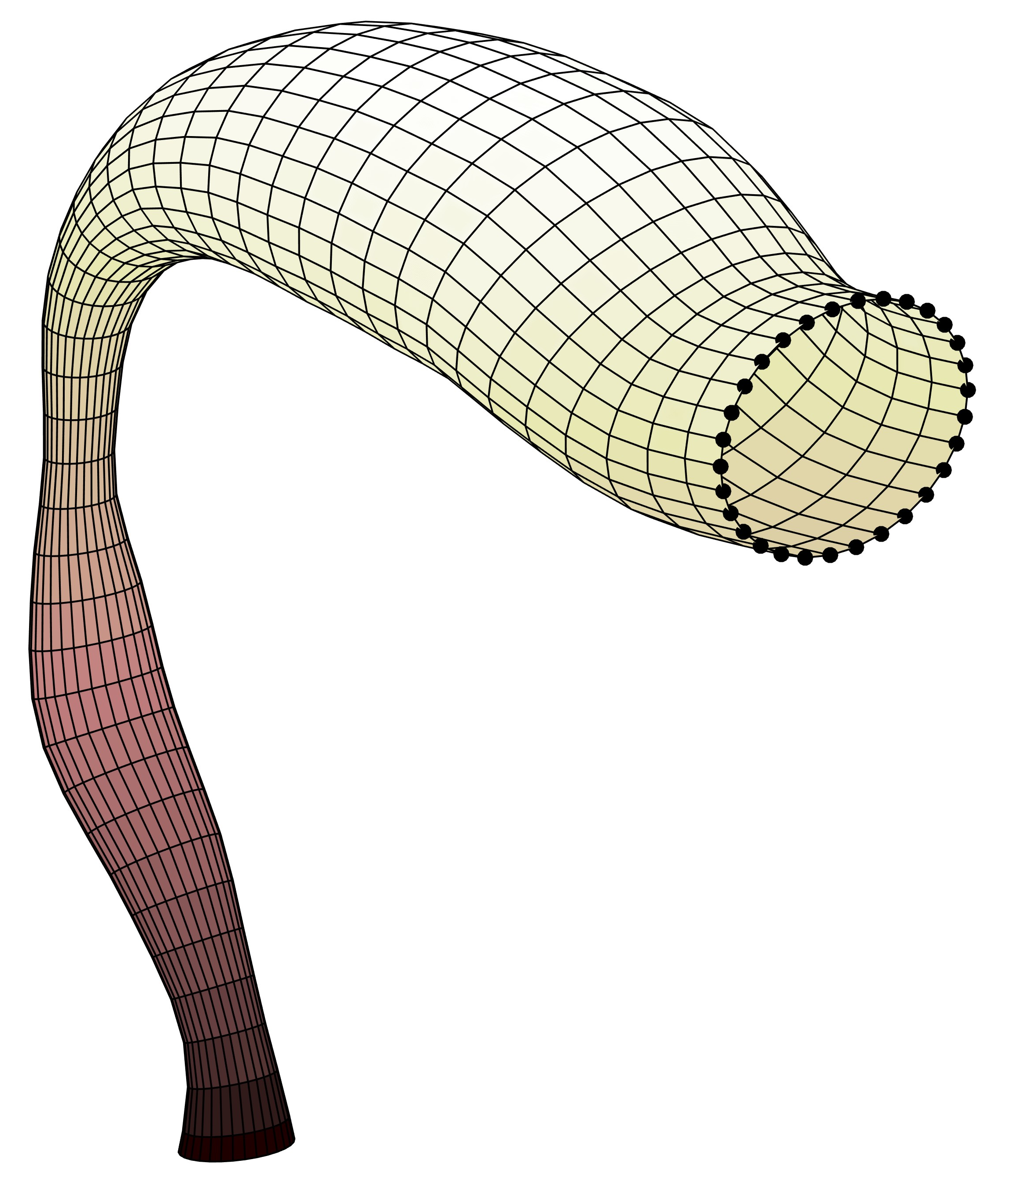
VT2
B. Story, Univ. Arizona

Slide 14
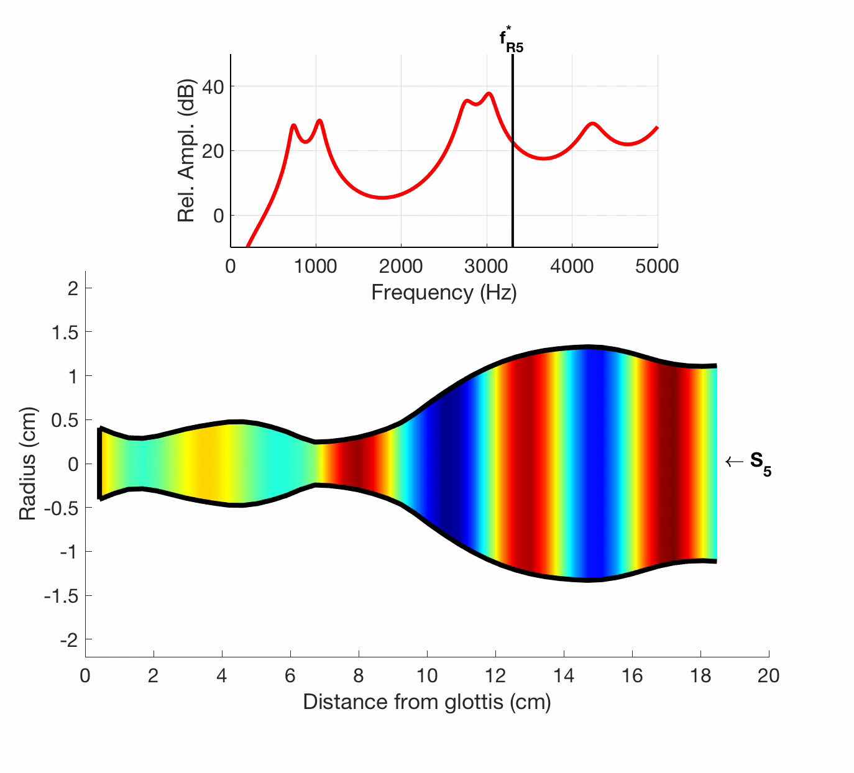
VT3
Target resonance frequency
S₅ sensitivity function superimposed on VT shape
B. Story, Univ. Arizona

Slide 15
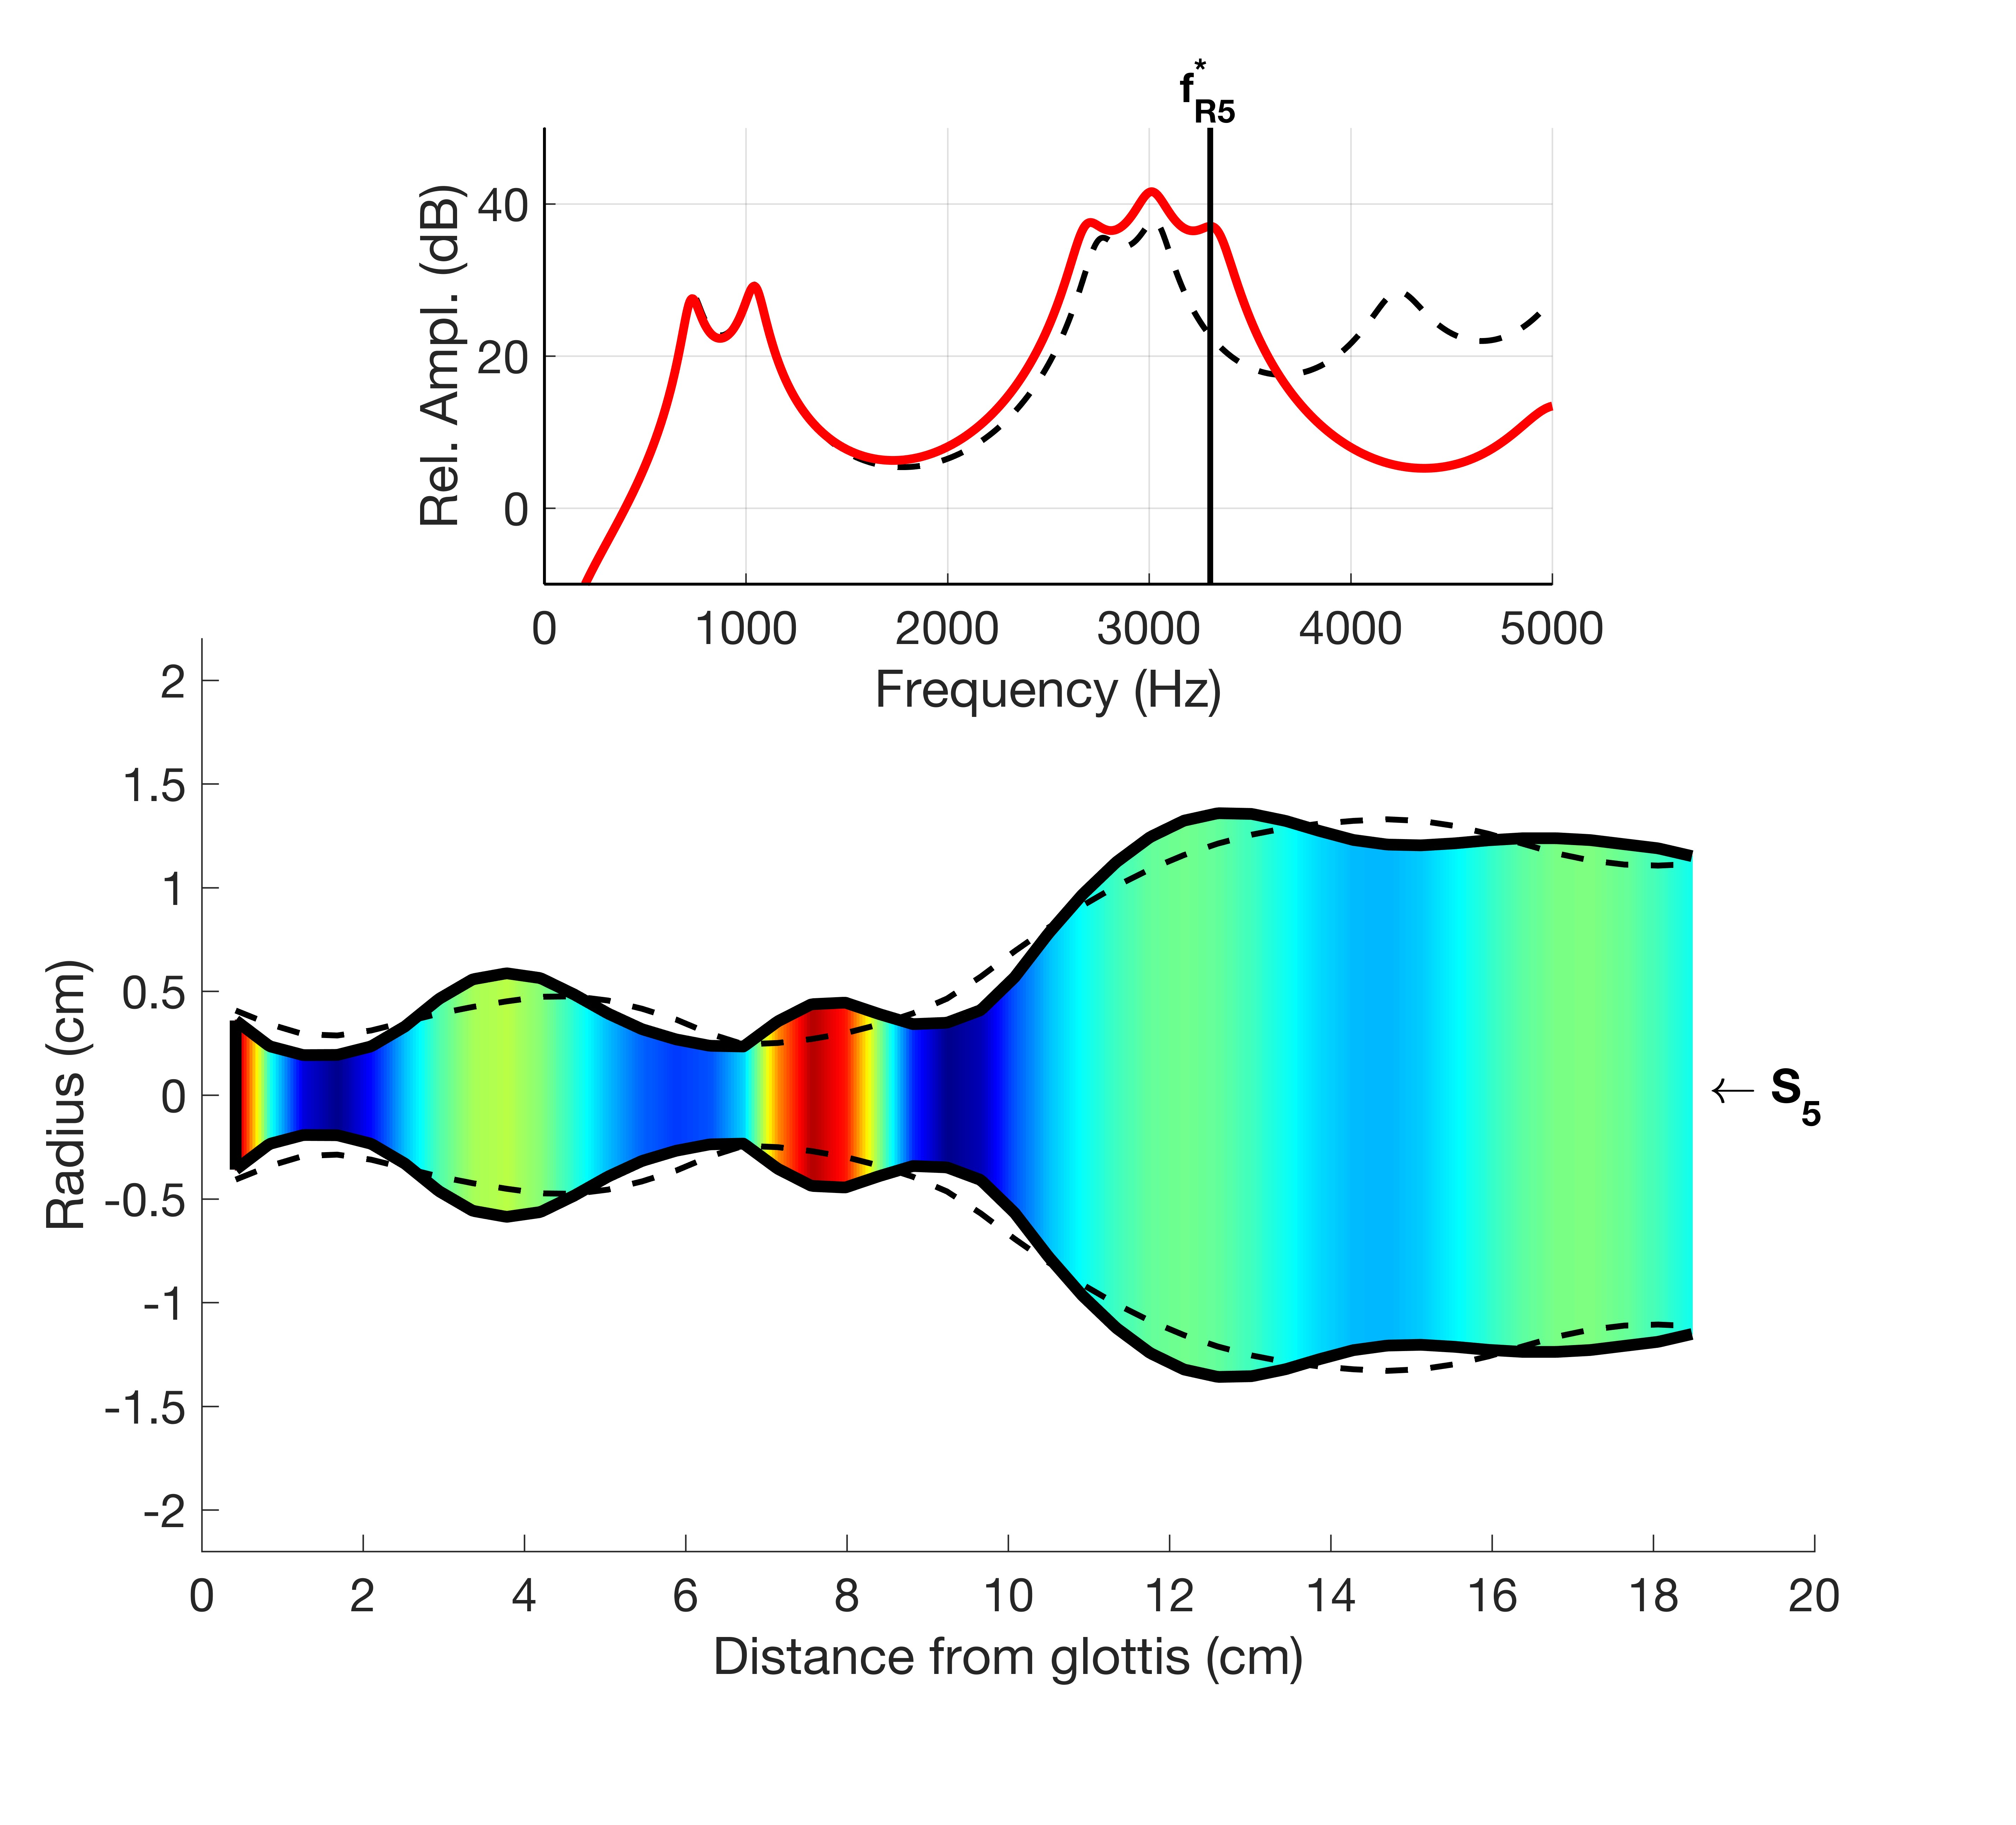
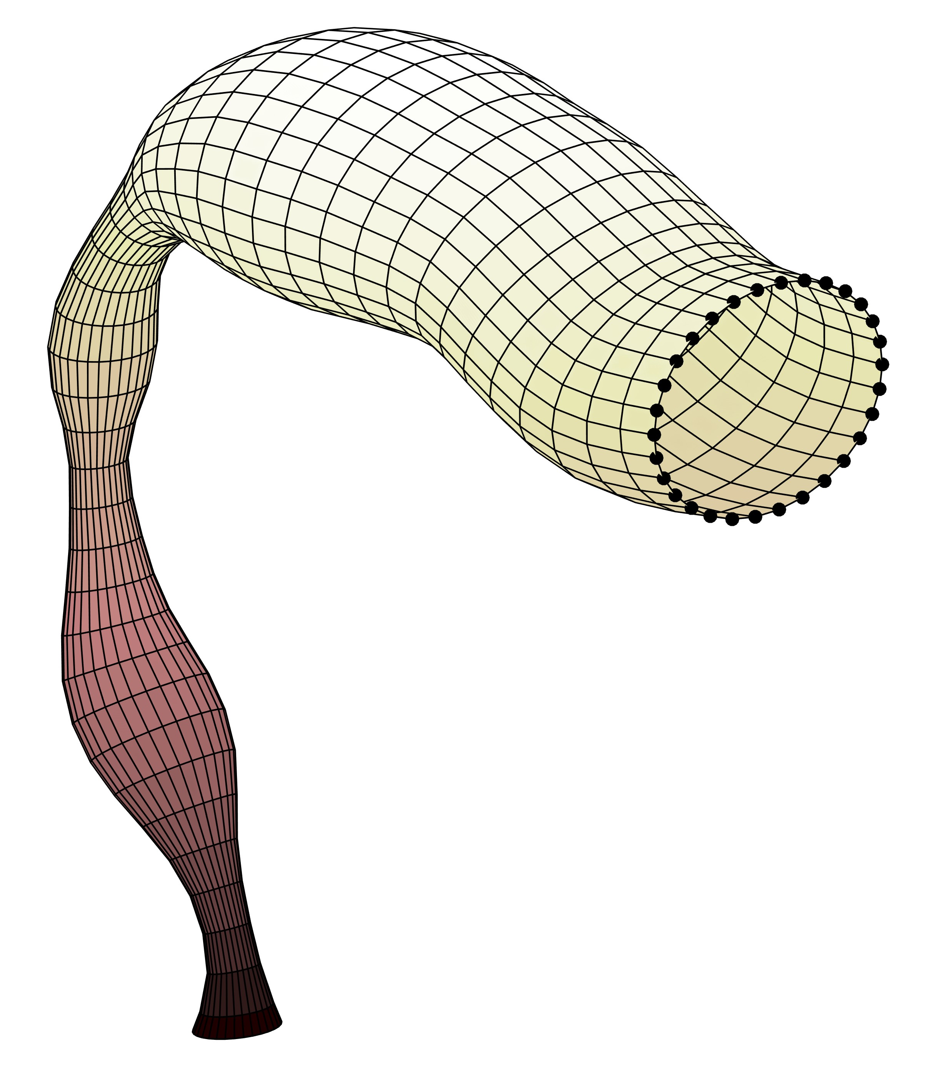
VT3
B. Story, Univ. Arizona

Slide 16
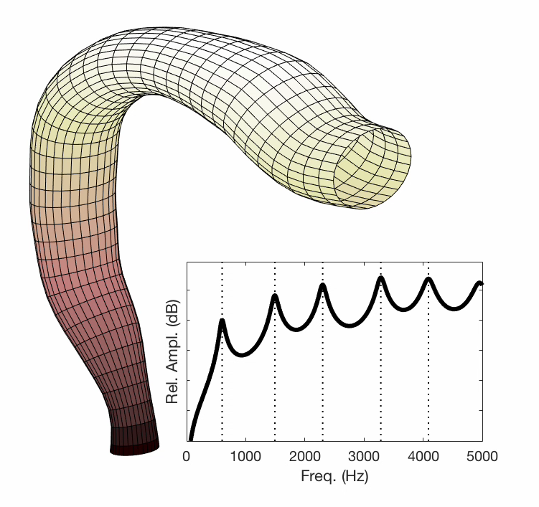
Animation of all modifications
B. Story, Univ. Arizona

Slide 17
Measured vocal tract shape based on MRI
Baritone - known to produce a distinct “singing formant”
singing formant
?
B. Story, Univ. Arizona

Slide 18

Measured vocal tract shape based on MRI
Baritone - known to produce a distinct “singing formant”
singing formant!
WQ
B. Story, Univ. Arizona
Story, (2016). Handbook of singing

