Slide 1
Stories of speech science
Acoustical Society of America
12.06.17
Brad Story
Speech Acoustics Laboratory
Speech, Language, and Hearing Sciences
University of Arizona

Slide 2
Note 1: This set of slides was part of a presentation given at the meeting of the Acoustical Society of America in New Orleans, LA on December 6, 2017 during a special session on education in Speech Science.
Story, B. H. (2017). Stories of speech science. The Journal of the Acoustical Society of America, 142(4), 2616-2616.
Abstract
A fundamental aspect of teaching, on any topic, is the continual pursuit of telling a story. Although technology and advances in teaching methods may facilitate new and exciting forms of presenting course materials, they do not, by themselves, build the context for the content of a course. Every lecture, activity, homework assignment, project, quiz, and examination can be regarded as chapters that build, over the duration of a course, a compelling and engaging story in which students take part. The aim of this talk is to encourage development of speech science courses that weave together history, theory, technology, visual and auditory experience, assessment, and, importantly, the instructor’s own research to spin a good tale. [Work supported by NIH R01-DC011275 and NSF BCS-1145011.]
Brad Story, Acoustical Society of America, Dec. 2017

Slide 3
Note 2: The goal of the special session was for the presenters to share information regarding teaching techniques, classroom demonstrations, and other aspects of improving and enhancing education in Speech Science.
As indicated in the abstract on the previous slide, my view is that one essential aspect of teaching is to tell a good story. The slides that follow are simply an example of how I have presented an introduction to speech perception in my courses on both Speech Science and Speeech Perception. The story that I set up is one where speech perception is like figuring out a code – and there is a bit of “mystery” built into the story.
Brad Story, Acoustical Society of America, Dec. 2017

Slide 4
Why a story?
A story gives someone a reason to be interested, and a reason to care.
Story design
A story should exploit the fact that we are all born to solve problems.
An absence of select information draws people in.
  ``Unifying theory of 2+2'' - give the audience a 2, a plus sign, and a 2, and let them come to the conclusion that it equals 4.
  Andrew Stanton, Pixar Studios
Brad Story, Acoustical Society of America, Dec. 2017

Slide 5
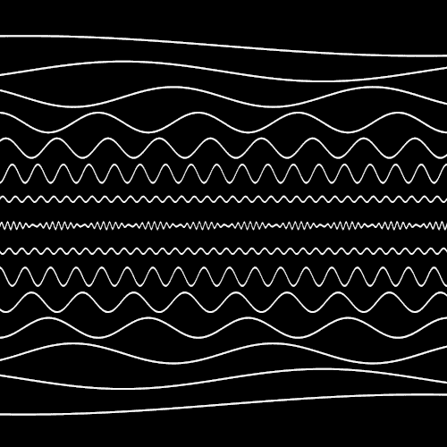
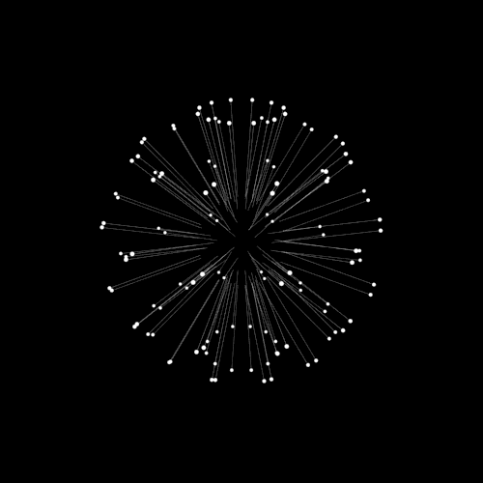
“Communication takes place when one mind acts upon its environment... such that another mind is influenced, ... and in that other mind an experience occurs which is like the experience in the first mind.” Richards, 1928
Brad Story, Acoustical Society of America, Dec. 2017

Slide 6
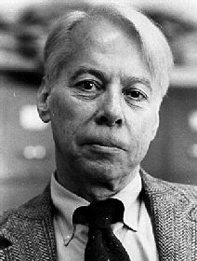
In 1968…
“Our concern is with the question: how is it that on hearing the acoustic stream of speech a listener perceives phonemes?
There are two compelling reasons for an interest in the question.
First, there are several indications that phonemes could not be communicated by a simple cipher or sound alphabet.
Second, there is good evidence that phonemes are not, in fact, communicated in this simple way, but are, rather, recovered from a special code.”
Alvin Liberman
Haskins Laboratories
Liberman, Α. Μ., et al. "On the efficiency of speech sounds." STUF-Language Typology and Universals 21.1-6 (1968): 21-32.
Brad Story, Acoustical Society of America, Dec. 2017

Slide 7
What is a cipher?
Replacement of letters of the alphabet with other symbols.
Sherlock Holmes – The Dancing Men
The Caesar Cipher
Brad Story, Acoustical Society of America, Dec. 2017

Slide 8
An acoustic cipher = replacement of phonemes with acoustically unique sounds.
Could speech be produced and perceived like an acoustic alphabet?
i.e. a string of separate, distinct sounds concatenated to produce words
Sound 1
Sound 2
Sound 3
Sound 4
=
word
Brad Story, Acoustical Society of America, Dec. 2017

Slide 9

“tip”
“trip”
“rip”
“pit”
Brad Story, Acoustical Society of America, Dec. 2017

Slide 10
trip tip pit rip
Brad Story, Acoustical Society of America, Dec. 2017

Slide 11
What is different about an acoustic alphabet relative to natural speech?
Preservation of temporal order
Coarticulation
Maybe speech is rather a code than a cipher
a set of operations or rules that encode a message.
Brad Story, Acoustical Society of America, Dec. 2017

Slide 12
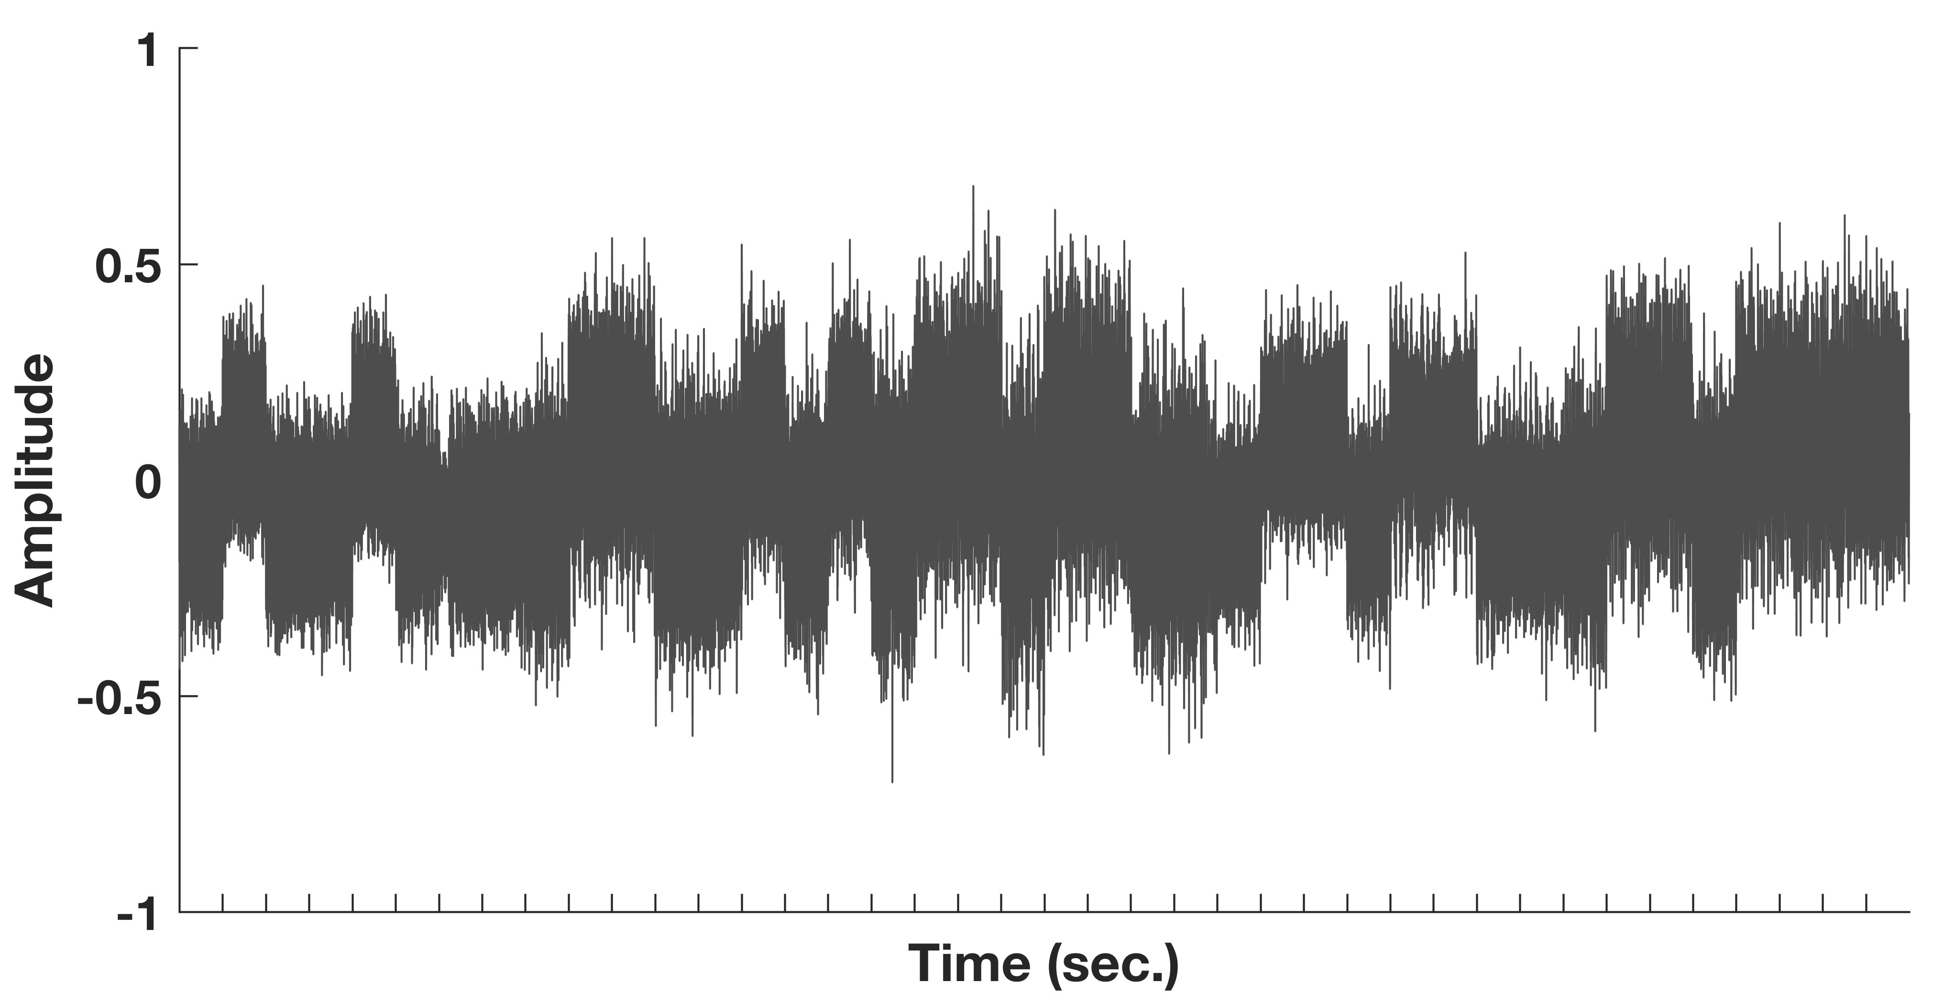
A mysterious signal with a message
Our Assignment:
Analyze the signal to decode the message
Note: By this point in the course, students have encountered spectrograms, filters, and some basic acoustic analysis
Brad Story, Acoustical Society of America, Dec. 2017

Slide 13
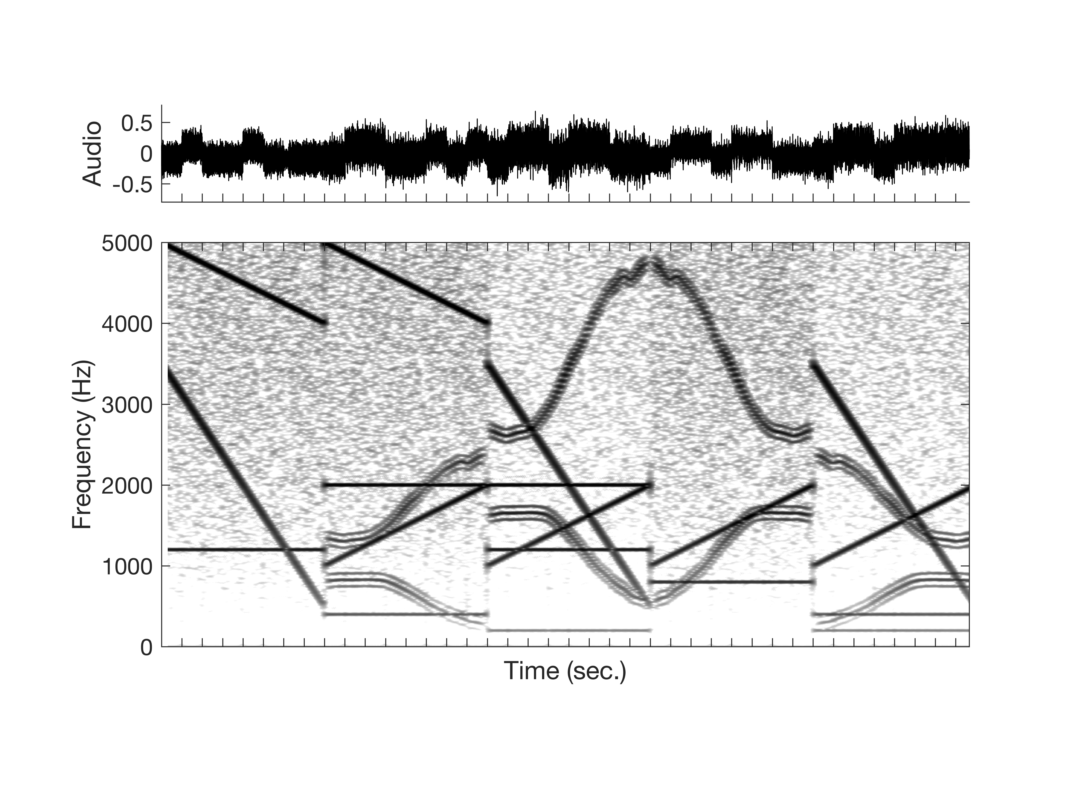
Where to start?
Spectrogram:
Noise
Rising tones,
Falling tones,
Sustained tones,
Discontinuities,
Sweeping tone clusters
Not much success until we stumble onto a set of “rules” for analyzing and decoding the signal.
Brad Story, Acoustical Society of America, Dec. 2017

Slide 14
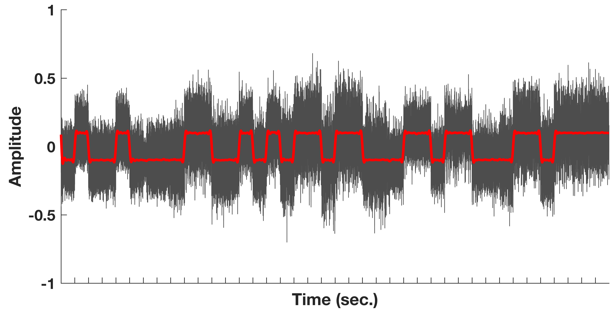
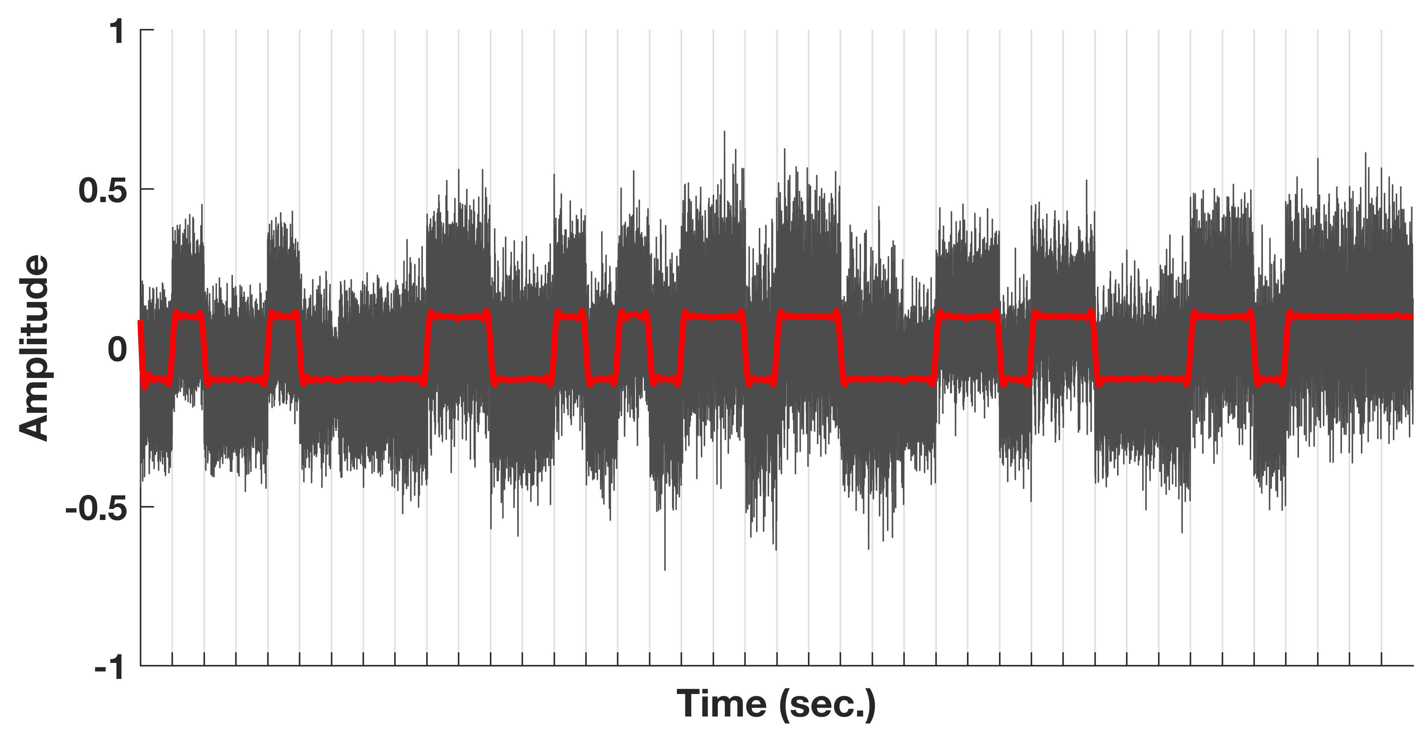
Rule 1: Low pass filter signal to remove high frequency components.
Rule 2: Determine the mean amplitude in consecutive 100 ms sections.
If the mean value of the section is less than zero, assign value of 0
If the mean value of section is greater than zero, assign value of 1
Brad Story, Acoustical Society of America, Dec. 2017

Slide 15

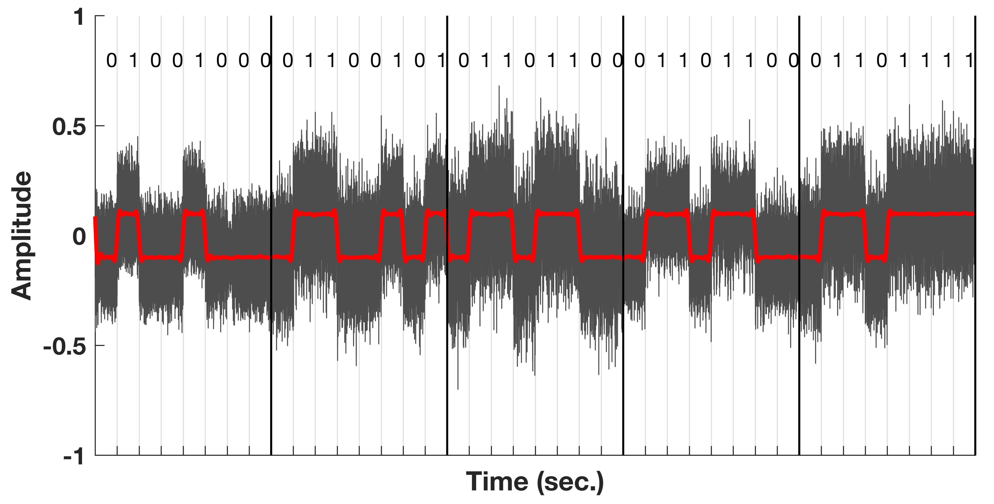
Rule 2: Results
Rule 3: Collect 0s and 1s for every eight consecutive 100 ms sections
Brad Story, Acoustical Society of America, Dec. 2017

Slide 16
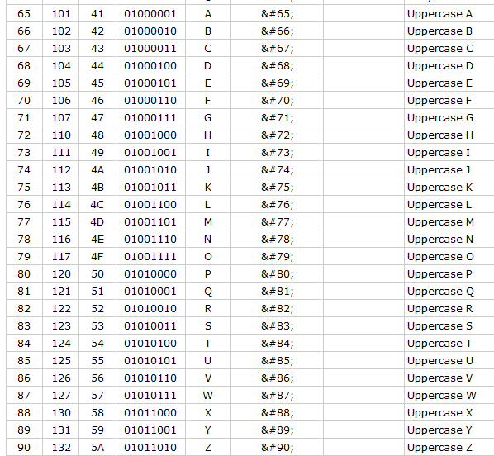
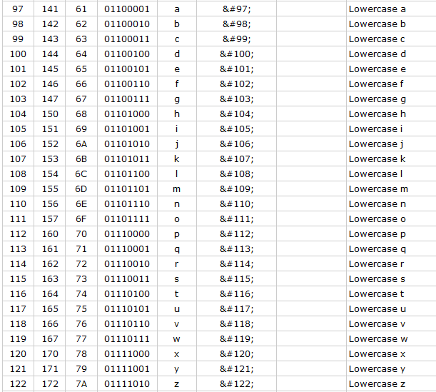
H
e
l
l
o
Rule 4: Match each pattern of 1s and 0s to an entry in a codebook
Brad Story, Acoustical Society of America, Dec. 2017

Slide 17

Even though the rising, falling, and sweeping tones are prominent features in the signal they are irrelevant with regard to the rules used to decode the message.
Note: Follow up with homework assignment where students apply a set of rules to decode a signal.
Brad Story, Acoustical Society of America, Dec. 2017

Slide 18
Speech Communication
Linguistic information is encoded in the speech signal (via speech production) by some set of “rules.”
Through speech perception listeners decode the speech signal by making use of those same rules.
Experimental and theoretical accounts of speech perception are focused, implicitly or explicitly, on finding and understanding the rules of the code.
Brad Story, Acoustical Society of America, Dec. 2017

Slide 19
Our quest in this course:
To understand what science has uncovered about this code – and also what it has not uncovered, yet.
Brad Story, Acoustical Society of America, Dec. 2017

Slide 20
Helpful literature on teaching
“Small Teaching”; “Cheating Lessons” by James Lang,
“What the Best College Teachers Do,” by Ken Bain
“Make it Stick,” by Brown, Roediger, and McDaniel.
“Improving How Universities Teach Science,” by Carl Weiman (Nobel Prize in Physics 2001)

