Slide 1
Laurel or Yanny?
Brad Story
Speech, Language, and Hearing Sciences
University of Arizona
May 22, 2018
During May 2018, a Twitter meme containing an audio file from an online dictionary asked readers to decide if they heard the name “Laurel” or “Yanny” (the original audio was linked to the word “laurel”). The meme went viral and responses showed nearly an even split between listeners for each name.
I was initially contacted by one media source to comment on the meme and provided a brief acoustic analysis. My explanation and graphic is shown to the right. This was subsequently (and very rapidly) found by other media sources and resulting in more requests for comment.
Other explanations were circulating too. Quality of signal, compression, spectral tilt, perceptual weighting, high versus low frequency bands, and masking effects were some the areas of focus - all possible contributors to the effect. Another idea was that the audio file contained two “tracks” – one that was “Laurel” and another “Yanny” – and somehow they had been merged to produce the dichotomy (this explanation suggests the entire event was pre-meditated).
It was also shown that shifting all frequencies in the audio signal downward by 20-30% revealed “Yanny” to most listeners. That was an interesting finding because it suggests that the third formant in “laurel”, when shifted downward in frequency, could be taken as the second formant in “yanny”; in addition the downward shift in frequency likely produces conditions were F1 and F2 of “Laurel” perceptually merge and become a single formant.
These slides are provided to be used as a demonstration of the Laurel/Yanny effect

Slide 2

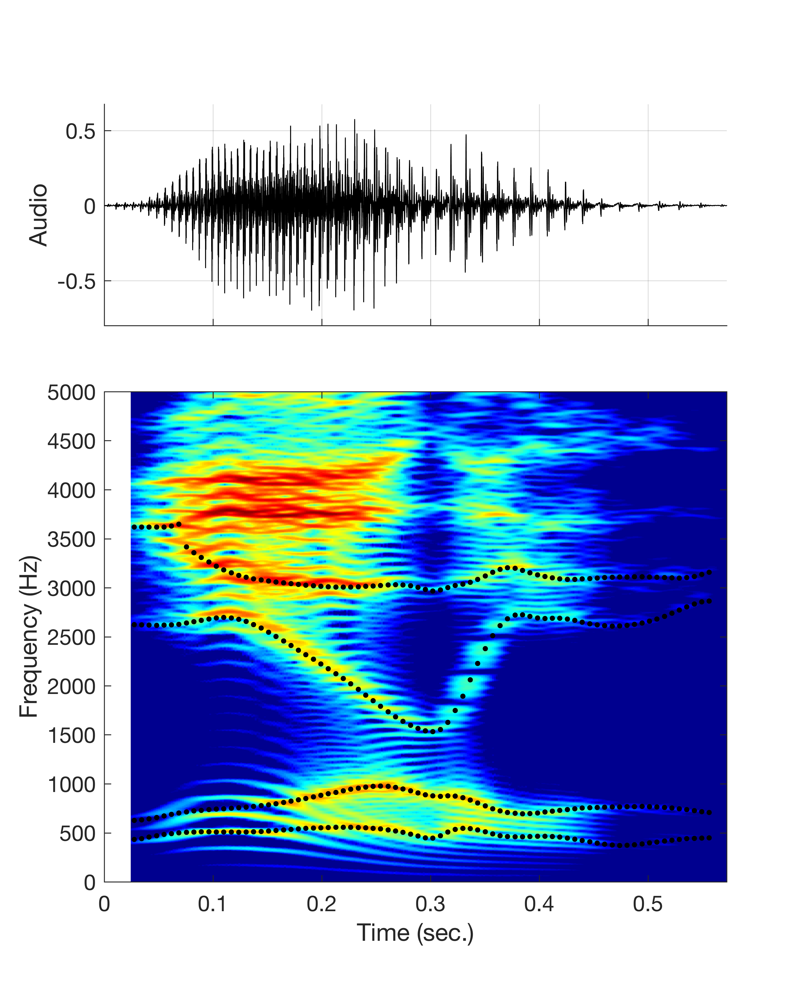
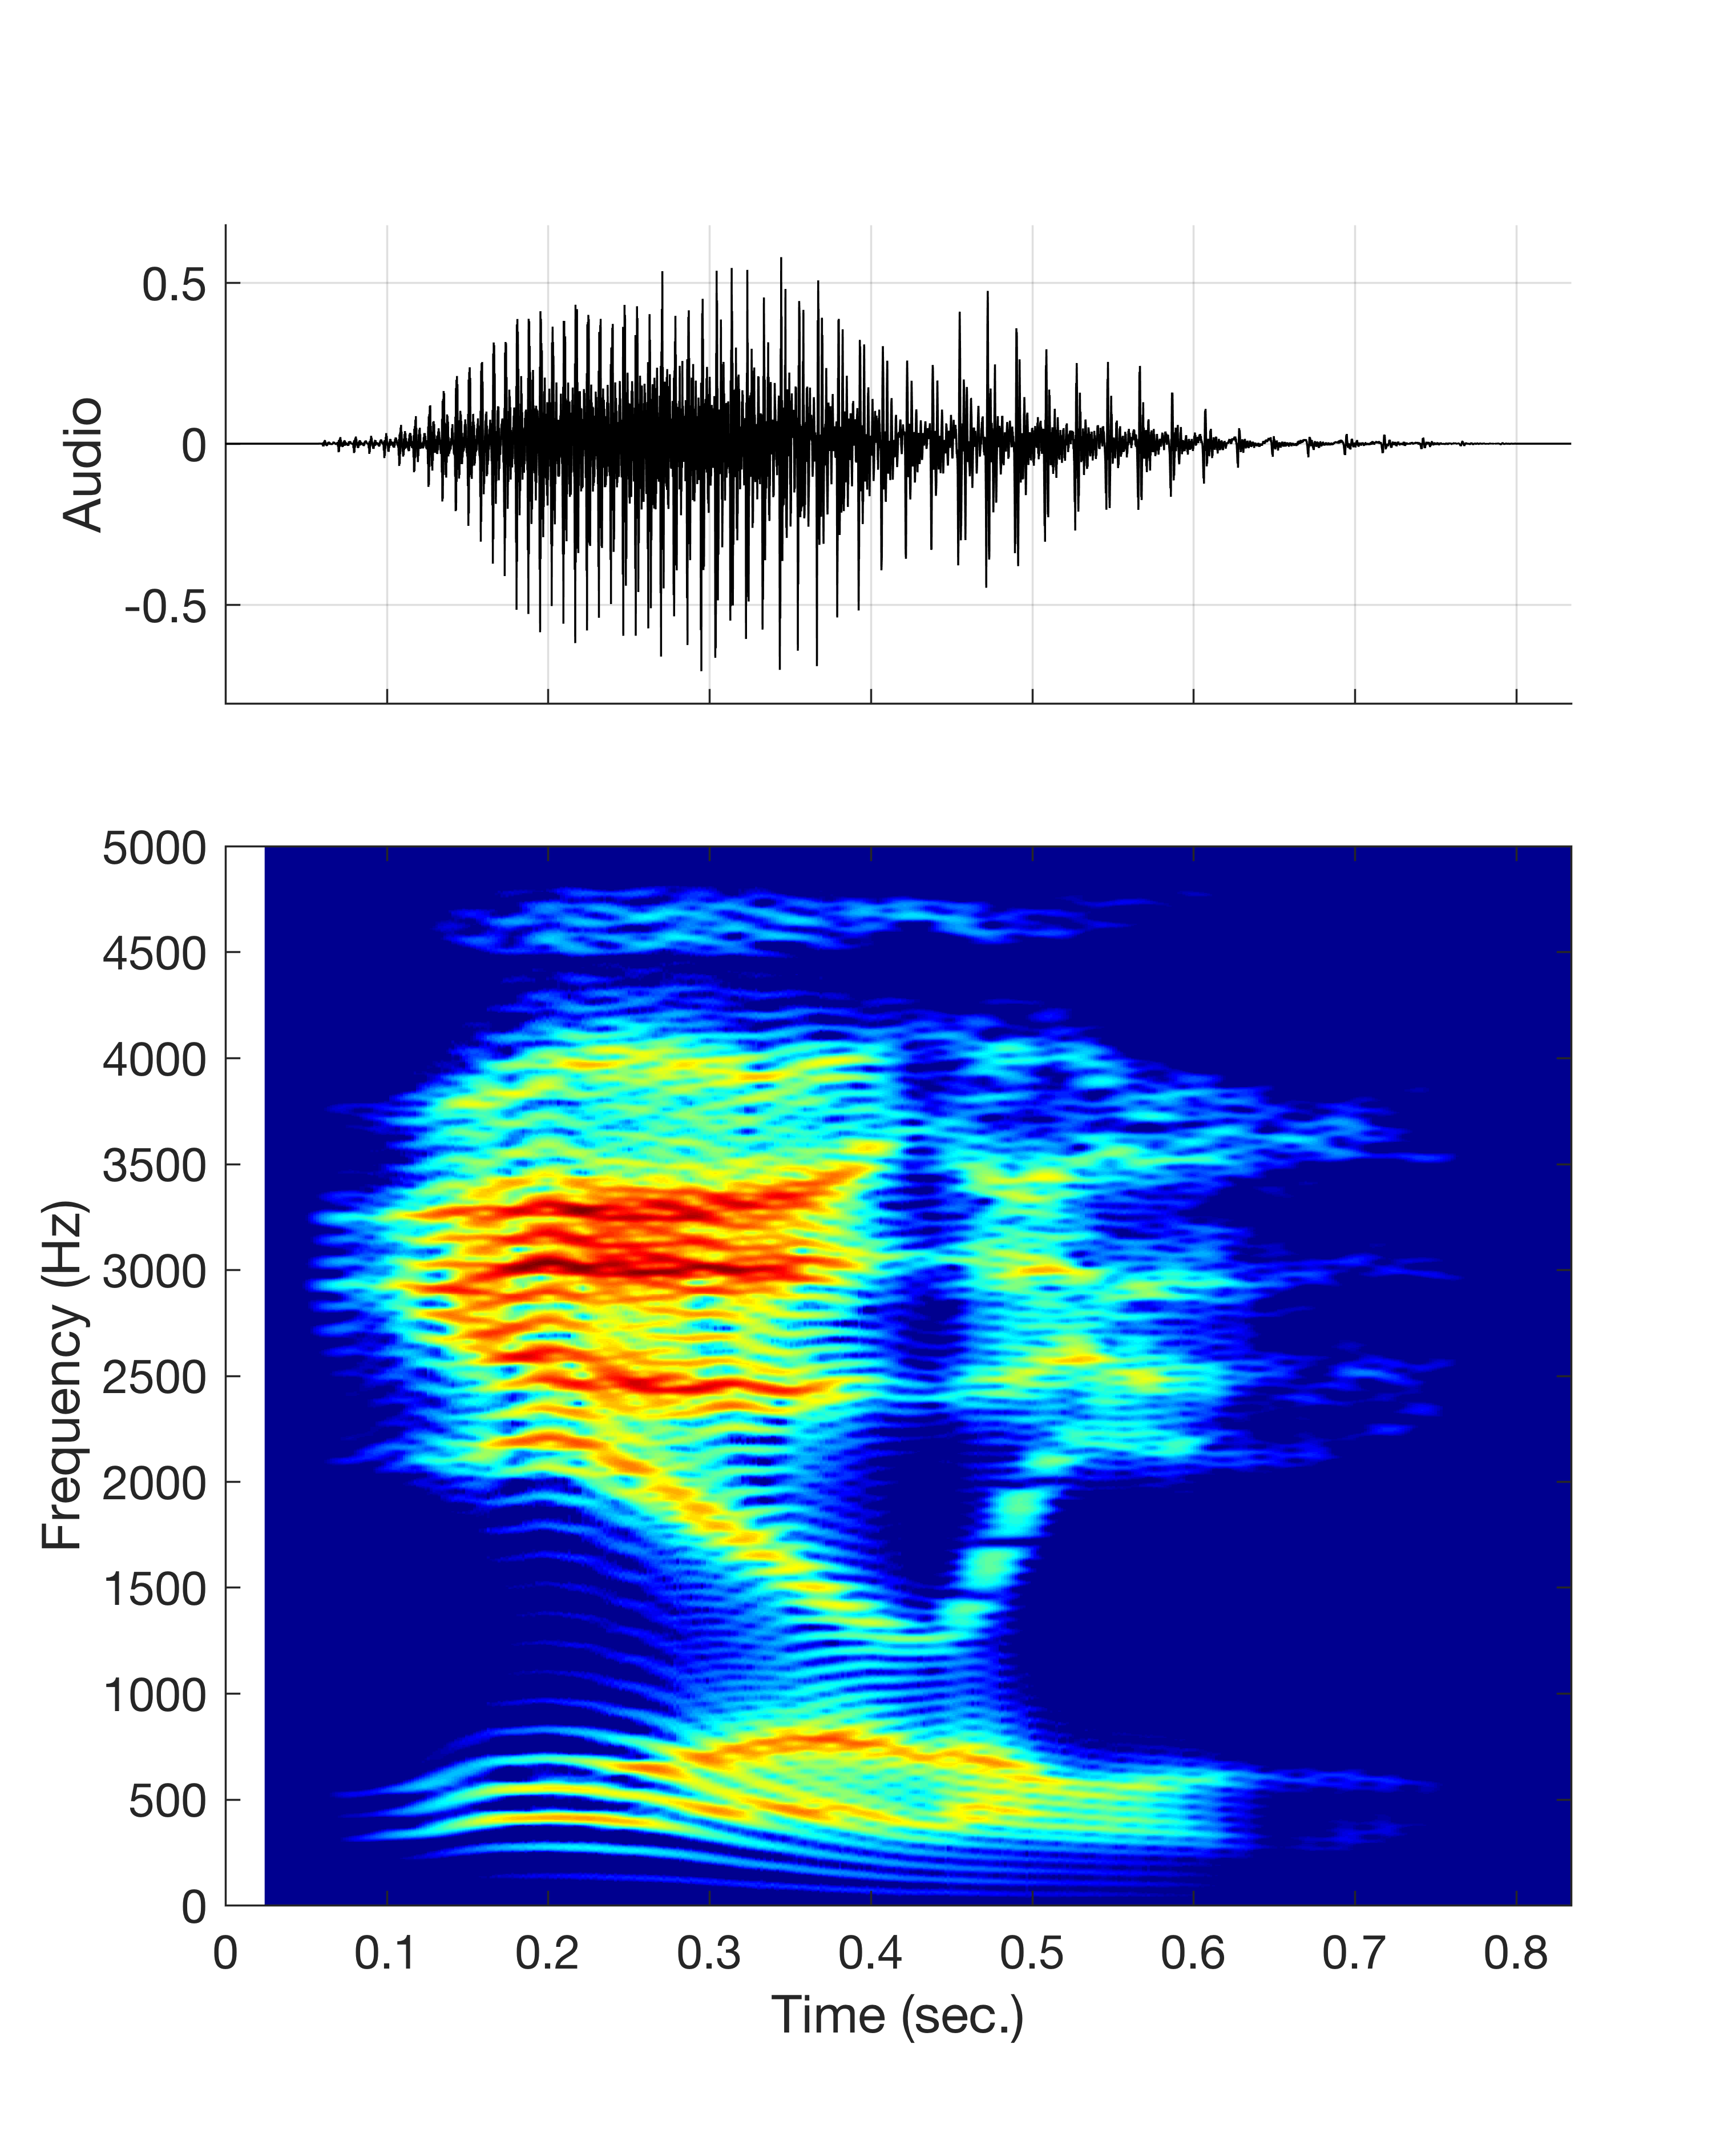
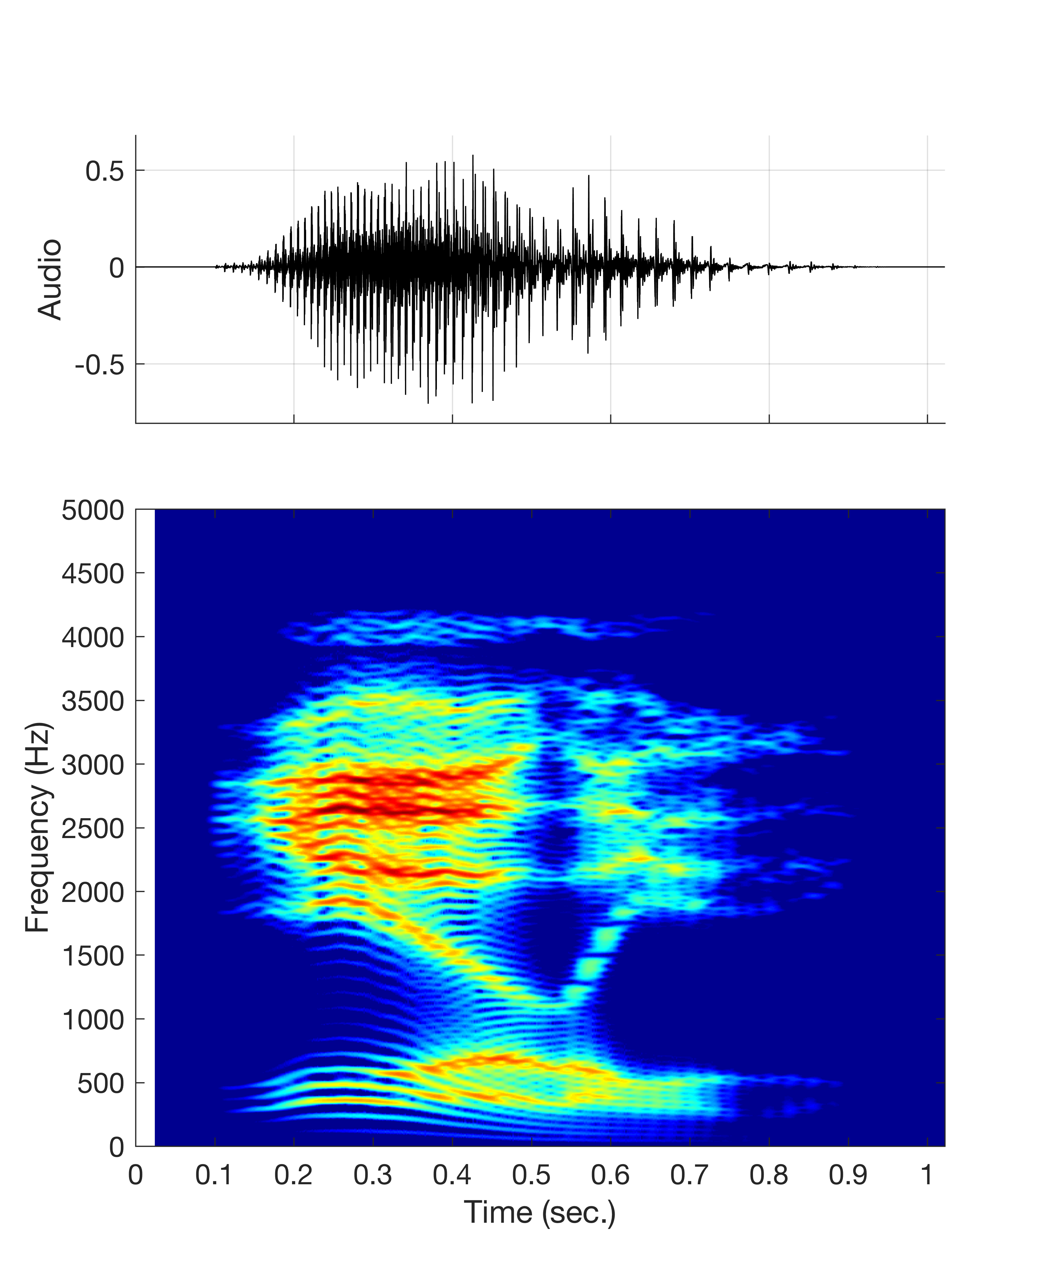
Laurel or Yanny?
Brad Story, University of Arizona, 05.22.2018
In order to rule out any bizarre or particularly special quality of the original twitter audio signal, and to allow for flexible control of voice source and vocal tract parameters, a version of “laurel” was generated with TubeTalker*, a computational model of speech production.
An audio signal was generated by specifying the vocal tract modulations (analogous to articulatory movements) required for the word “laurel” – that is, nothing “Yanny”-like was specified at all.
The unaltered TubeTalker version is shown below in the first panel (far left) as a waveform and narrowband spectrogram. The black dots the vocal tract resonances (formants) that were calculated during the production of the word. The gray audio icon will play the original signal, whereas the orange icon will play a pre-emphasized version. Pre-emphasis tilts the spectrum +6 dB per octave which may enhance the effect. The narrow band spectrogram show
Frequency shifted versions are shown from left to right. The numbers above each sample indicate the frequency scale factor (i.e. .9 means frequency was downshifted by 10%).
Listen to each and decide Laurel or Yanny. If you play samples consecutively from left to right and then from right to left, you may experience a hysteresis effect. That is, you may shift from “Yanny” back to “Laurel” at a different sample than the shift from “Laurel” to “Yanny”.
1
.9
.85
.8
.78
.75
.7
TubeTalker
TubeTalker
(pre-emphasized)

Slide 3
Laurel or Yanny?
Brad Story, University of Arizona, 05.22.2018
The audio samples below are the entire series of frequency shifted versions of TubeTalker’s “Laurel”. The progression follows this set of frequency shift scale factors:
1 .9 .85 .8 .78 .75 .70 .75 .78 .8 .85 .9 1
TubeTalker
TubeTalker
(pre-emphasized)
*TubeTalker references
Story, B.H., (2005). A parametric model of the vocal tract area function for vowel and consonant simulation, J. Acoust. Soc. Am., 117(5), 3231-3254.
Story, B.H., and Bunton, K., (2010). Relation of vocal tract shape, formant transitions, and stop consonant identification, J. Spch. Lang. Hear. Res., 53, 1514-1528.
Story, B.H., (2013). Phrase-level speech simulation with an airway modulation model of speech production, Computer Speech and Language. 27(4), 989-1010.
Story, B. H., and Bunton, K., (2017). An acoustically-driven vocal tract model for stop consonant production, Speech Comm., 87, 1-17. Final version published online: 20-Dec-2016. DOI: 10.1016/j.specom.2016.12.001.

Slide 4
Laurel or ????
Brad Story, University of Arizona, 05.22.2018
Just for fun, the audio samples below are the entire series of frequency shifted versions of TubeTalker’s “Laurel” played in reverse. The progression again follows this set of frequency shift scale factors:
1 .9 .85 .8 .78 .75 .70 .75 .78 .8 .85 .9 1
TubeTalker - Reversed
TubeTalker - Reversed
(pre-emphasized)

